Slide 1
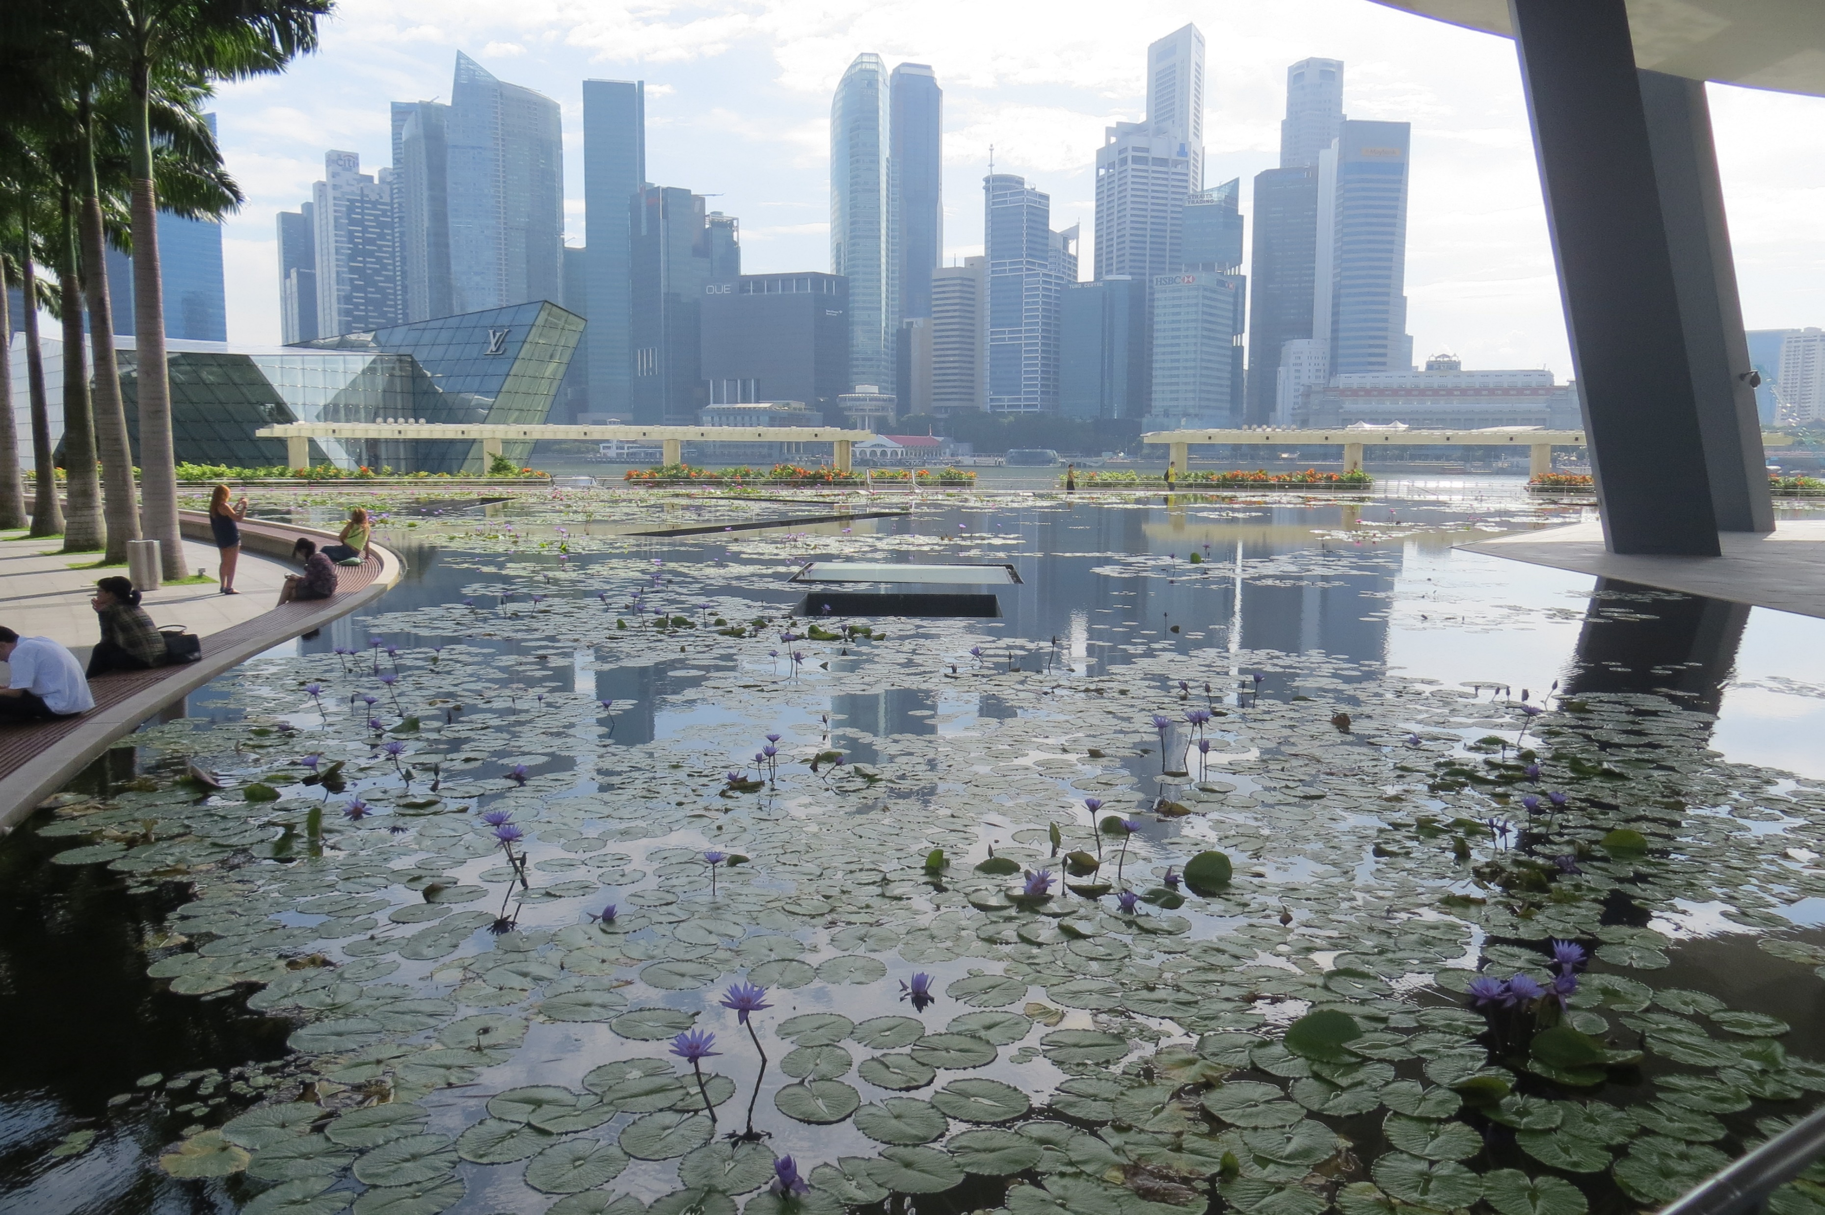
16th AIDA CLIMATE & CATASTROPHIC EVENTS WORKING PARTY MEETING 08:30hrs-10:30hrs - WEDNESDAY 18 OCTOBER 2017 ASIA-PACIFIC INSURANCE CONFERENCE RAFFLES CITY CONVENTION CENTRE – RAFFLES CITY – SINGAPORE
AGENDA
Chairman’s Introduction – Tim Hardy (UK)
Insurance in Times of Climate Change – Recent Cyclonic Events in the USA – Richard Traub (US)
Update on Catastrophe Bonds – Paolo Rainelli (Italy)
New Zealand - Land of the Long White (Dust) Cloud
– Richard Johnstone (NZ)

