Slide 1
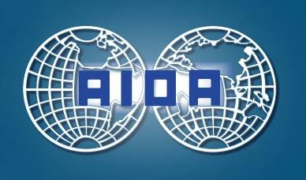
Association Internationale de Droit des Assurances
International Insurance Law Association
Associazione Internazionale di Diritto delle Assicurazioni
Internationale Vereinigung Versicherungsrecht
Asociacion Internacional de Derecho de Seguros
8th AIDA CLIMATE CHANGE WORKING PARTY MEETING
16:00hrs-18:00hrs - 29 September 2014
Fracking:
Particular legal and coverage problems presented
by the extraction of shale oil and gas
XIVth AIDA WORLD CONGRESS ROME
European University of Rome - Via Degli Aldobrandeschi

Slide 2
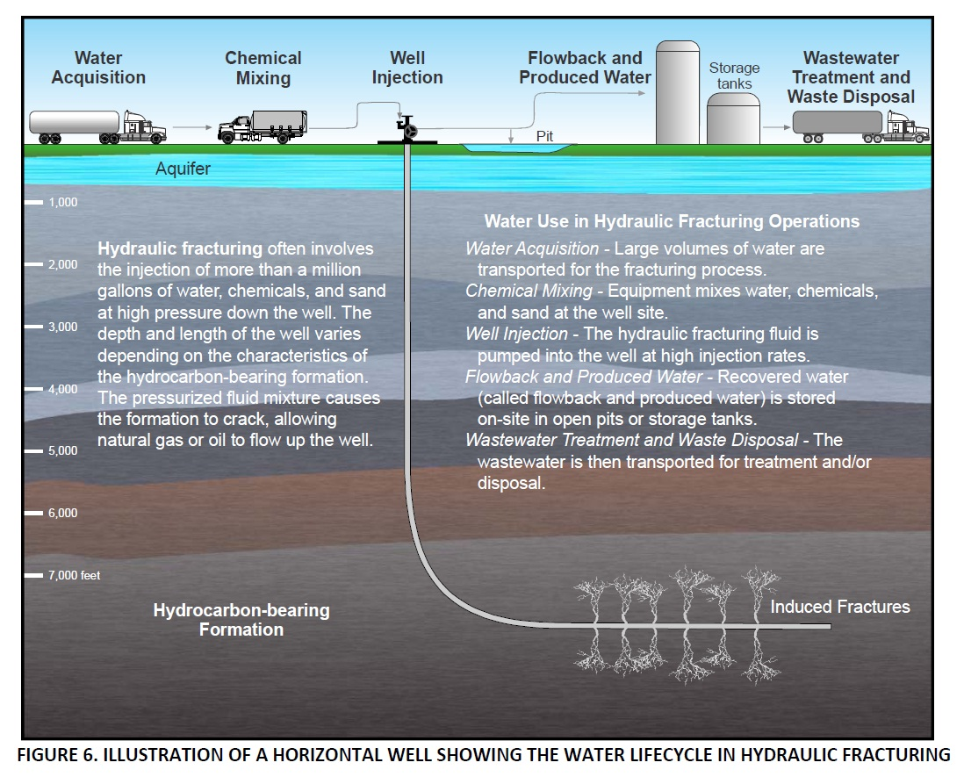
Fracking:
Particular legal and coverage problems presented 8th CCWP Meeting by the extraction of shale oil and gas Rome - 29.9.14
How hydraulic fracturing (“fracking”) for recovery of shale oil or gas (SOG) actually works (evwind.es)
(NB process of “fracking” itself is not new, but evolution of deep fracking/horizontal drilling for SOG is)

Slide 3
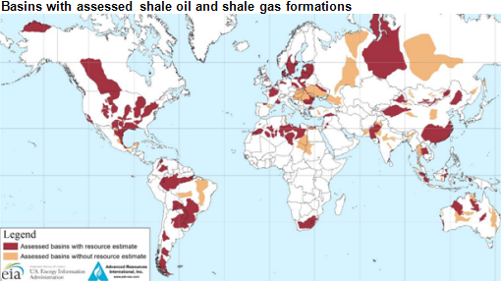
Fracking:
Particular legal and coverage problems presented 8th CCWP Meeting by the extraction of shale oil and gas Rome - 29.9.14
Where has shale oil or gas been located ? (EIA – US Energy Information Administration Report - Jan 2014)

Slide 4
Fracking:
Particular legal and coverage problems presented 8th CCWP Meeting by the extraction of shale oil and gas Rome - 29.9.14
Where has shale oil or gas been located ?
  137 shale formations so far identified in 42 countries
  Estimated to represent 10% of world’s crude oil and 32% natural gas resources
  Top countries for shale oil: (1) Russia; (2) US; (3) China; (4) Argentina; (5) Libya
  Top countries for shale gas: (1) China; (2) Argentina; (3) Algeria; (4) US; (5) Canada
Where is shale oil or gas being extracted?
  Currently only US and Canada are producing shale oil or gas in commercial quantities
  Poland was among the first of others to lease shale acreage and drill test wells
  Countries encouraging/embarking upon active exploration programmes include:
  Argentina, Australia, China, England, Mexico, Russia, Saudi Arabia, Turkey
  Countries/regions where bans or moratoria on fracking have applied and/or continue:
  France, Germany, Romania, Switzerland, parts of S Africa and UK (both since lifted),
  parts of Australia and the US.
  (per EIA Report and other sources , inc. AIDA CCWP responses )

Slide 5
Fracking:
Particular legal and coverage problems presented 8th CCWP Meeting by the extraction of shale oil and gas Rome - 29.9.14
So what/where/whose are the potential risks?
How easily are they insurable? How easily may legal/coverage issues be resolved?
    Many continuing contentions made about the supposed risk/safety of fracking.
    Prominent among risks/claims already being contested in the US and elsewhere:
    - Contamination of groundwater
    - Methane pollution and its impact on climate change
    - Air pollution
    - Exposure to toxic chemicals
    - Blowouts due to gas explosion
    - Waste disposal
    - Large volume water use in water-deficient regions
    - Fracking-induced earthquakes
    - Workplace safety
    - Infrastructure degradation

Slide 6
Fracking:
Particular legal and coverage problems presented 8th CCWP Meeting by the extraction of shale oil and gas Rome - 29.9.14
AIDA CCWP FRACKING QUESTIONNAIRE – In your own country/region…
Q1 | Shale oil/gas (SOG) identified/being extracted? (if not, go to Q5)
Q2 | What claim to SOG or other legal rights do landowners/neighbours enjoy?
Q3 | What legal or political objections have so far manifested themselves?
Q4 | What regulations govern fracking? New ones or those existing for other hydrocarbon extraction? Is insurance of operations obligatory?
Q5 | What private market insurance products are available – for first party or third party risks?
Q6 | Insurance pools or State-supported compensatory schemes in existence?
Q7 | What environmental liability regime governs? Strict liability? “Polluter pays”?
Q8 | Limitations/challenges for insurance becoming available? Still too uncertain?
Q9 | Most important actual/anticipated legal/coverage problem areas?
Q10 | Major disputes so far emerged? Legal rulings resulting or pending?

Slide 7
Fracking:
Particular legal and coverage problems presented 8th CCWP Meeting by the extraction of shale oil and gas Rome - 29.9.14
Snapshot of responses to date | US (with thanks to Rich Traub) | Australia (with thanks to Chris Rodd) | UK
2. Ownership of oil/gas or land in which to be found/extracted: Is any oil or gas deemed by law to belong to the State, to the landowner of any land beneath which it lies or to someone else or does it vary according to circumstances? What rights do landowners have to constrain extraction, or enjoy the financial benefits derived from shale gas or oil extracted? | Oil/gas belongs to landowner of property under which found – where drilling is horizontal over wide areas v many may have claims to financial benefit. | Oil/gas belongs to State/territory in which located. Exclusive licences conferred upon operators, subject to latter having to comply with rights of access/restrictions and in some jurisdictions compensation for loss of use/earnings etc (Also, recognition of indigenous people rights.) | All hydrocarbons belong to Crown/State. Exclusive licences granted to operators, who must additionally obtain legal access, planning and operation consents and satisfy environmental and other obligations and conditions.

Slide 8
Fracking:
Particular legal and coverage problems presented 8th CCWP Meeting by the extraction of shale oil and gas Rome - 29.9.14
Snapshot of responses to date | US | Australia | UK
4. Regulations/Insurance: Do any regulations specifically address the question of what insurance coverage is in place? Is insurance coverage mandatory for any operators or operations? | Insurance requirements are varied . Illinois: Hydraulic Fracturing Act requires proof of cover for injury/loss/pollution etc to min of $5m before permit issued. Texas: Individual performance bonds permitted . | Petroleum approval regimes generally give licensing bodies power to require appropriate forms of security inc . insurance and may cancel where not provided. | Adequacy of insurance coverage of operators monitored by Govt dept which issues licences. Onshore oil /gas industry body promises by voluntary Charter to ensure operators have adequate insurance/ response plans in event of emergency appropriate for each site. Dec 2013 - Govt resisted calls that bonds be required (in case operators bankrupt by time of any major loss/claim).
Insurance pools/other forms of State-supported compensatory schemes Any in operation or contemplated? | No | No . Reliance placed on civil liability being found v operator holding adequate private liability insurance. | No. Govt has expressed view that current exploration practices ought not to affect availability of appropriate private insurance which has satisfied needs of UK onshore hydrocarbon exploration for 50yrs +.

Slide 9
Fracking:
Particular legal and coverage problems presented 8th CCWP Meeting by the extraction of shale oil and gas Rome - 29.9.14
Snapshot of responses to date | 5. Most important private market policies available + features | Problems for Insurers Major issues + contentious areas 10. Major (legal) disputes
US | Earthquake Insurance inc. with (or in addition to ) 1st py ppty insurance | 8. Problems for Insurers Each operation is different Conflicting/incomplete claims + underwriting data Location/proximity to people = critical Long-tail claims Major issues/contentious areas Sudden/gradual loss/damage Unexpected/unintended rqrt - lblty ins Absolute pollution exclsn issues Multiple occurrences/overlapping coverage – trigger/allocation/aggregation issues + timely reporting issues 10. Major disputes Warren Drilling v ACE American Insurance (2012) Analysis of application of CGL policy with Energy Pollution Liability Extension (EPLE) endorsement + 5 conditions of cover asserted by insurer
 | Business Interruption addition to comm ppty cover (requiring phys dam to own ppty) suitable for cos + municipalities
 | Contingency Business Interruption (where lost profits/business etc following well blowout etc to 3rd py premises)
 | Operator’s Extra Expense Cover (purchased by drilling cos. v. well blowouts etc )
 | D&O Liability as operator’s managers commonly sued for breaches of duties of care, regulations etc
 | Env Impairment Liability (v MD/BI + bod inj + clean-up costs) – often high retentions /restrictions Can extend to cover gradual pollution from multiple perils
 | Commercial General Liability (likely to exc pollution) to cover all involved with fracking process v 3rd py claims for MD/BI (beyond drillers to those involved with transport, waste etc)
 | Pollution Insurance (for operators because pollution exc from CGL covers)
 | Reinsurance

Slide 10
Fracking:
Particular legal and coverage problems presented 8th CCWP Meeting by the extraction of shale oil and gas Rome - 29.9.14
Snapshot of responses to date | 5. Most important private market policies available + features | Problems for Insurers Major issues + contentious areas 10. Major (legal) disputes
Australia | Domestic Property Insurance - no pollution/contamination exclusion , but care to ensure damage not excluded by exclsns for subsidence/movement etc or outside specified perils. (Also, causation issues, e.g. fracking deemed causative of insured peril , e.g. earthquake) | 8. Problems for Insurers Fracking in infancy in Australia Embargoes on process in some states/populated areas Domestic insurers reluctant to underwrite till regulation, better data, tailored exclsns/products in place Major issues/contentious areas Interplay of risks with specified/excldd perils + whether ppty itself damaged Pollution exclsns – interpretation of sudden/gradual loss/damage etc Multiple occurrences/overlapping coverage – indemnity trigger/allocation/aggregation issues Multiple jt tortfeasors + Q of contractual indemnities between operators + lessors + others Evidential issues – emissions/water pollution 10. Major disputes No litigation , but much lobbying and call for further legislation/regulation – currently dependent upon Environment Protection Act legislation - yet to be determined if wholly fit for purpose.
 | Commercial Property Insurance - generally contain pollution/contamination exclsns unless “sudden + accidental”
 | Operator’s Liability Insurance - Reluctance generally among domestic insurers to underwrite, preferring also reliance upon (untested) pollution/contamination exclsns
 | D&O + Environmental Impairment Liability Insurance - Similarly not generally provided by domestic insurers for those undertaking fracking operations – operators in Australia dependent upon specialist cover from Lloyd’s of London.

Slide 11
Fracking:
Particular legal and coverage problems presented 8th CCWP Meeting by the extraction of shale oil and gas Rome - 29.9.14
Snapshot of responses to date | 5. Most important private market policies available + features | Problems for Insurers Major issues + contentious areas 10. Major (legal) disputes
UK | Domestic /Commercial Property Insurance - no contracts presently known expressly to exclude loss/damage from fracking activities per se. Subject to specified perils/excluded perils , terms tailored depending upon proximity of property to shale field + susceptibility to earth movement, sink holes etc. Suggestions hard to corroborate that premium made unaffordable for unattractive locations. Business Interruption and Contingency BI – available to cater for potential impact of blowouts/lack of access etc | 8. Problems for Insurers Established UK onshore hydrocarbons ins market but early days for fracking UK embargo on process owing to fear of earthquake risk now lifted Limited claims or underwriting data + variance in risk per site/operation; most in UK near populated areas. Major issues/contentious areas Many still just potential concerns Unknown effect of “fracking” risks where specified/excldd perils + estblshg whether insured’s own ppty damaged Pollution exclsns – interpretation of sudden/gradual loss/damage etc Multiple occurrences/overlapping coverage – indemnity trigger/allocation/aggregation issues Multiple jt tortfeasors + Q of contractual indemnities between operators + lessors + others 10. Major disputes No coverage litigation to date. Much lobbying/revisions of legislation and regulation still current. Some past legal rulings re SOG ownership/access issues.
 | Bespoke Operator’s extra expense insurance, environmental liability (where otherwise excluded) , D&O Liability, public/excess liability cover for 3rd party phys damage and reinsurance all commonly available from specialist carriers for UK and other territories on terms.

Slide 12
Association Internationale de Droit des Assurances
International Insurance Law Association
Associazione Internazionale di Diritto delle Assicurazioni
Internationale Vereinigung Versicherungsrecht
Asociacion Internacional de Derecho de Seguros
8th AIDA CLIMATE CHANGE WORKING PARTY MEETING
16:00hrs-18:00hrs - 29 September 2014
Fracking:
Particular legal and coverage problems presented
by the extraction of shale oil and gas
XIVth AIDA WORLD CONGRESS ROME
European University of Rome - Via Degli Aldobrandeschi

