Slide 1


IDD and Bancassurance: identification of potential issues AIDA 2016
Presentation by Nic De Maesschalck, BIPAR Director
October 2016

Slide 2
Bancassurance – Assurfinance
Various forms of cooperation
Distribution perspective : Life/ IBIP’s/ Non life
Private consumer focus / commercial lines
Late 80’s

Slide 5
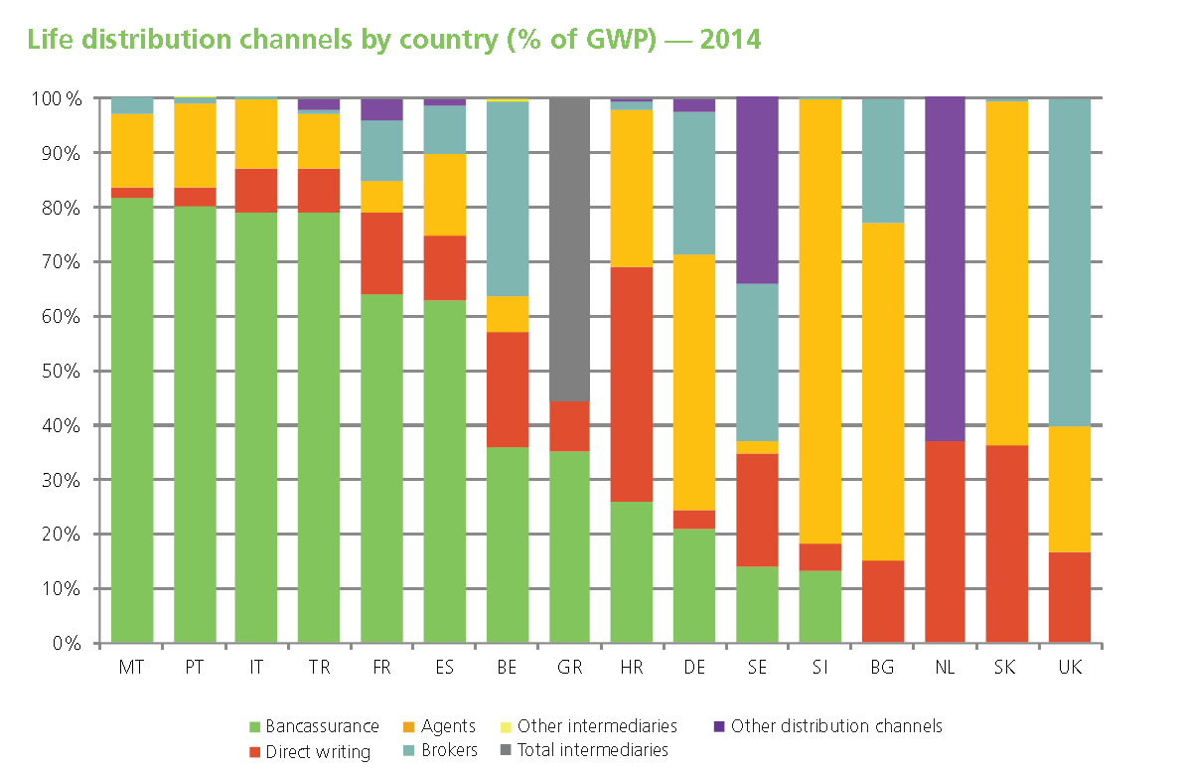
Source: Insurance Europe

Slide 6
IDD and Bancassurance

Slide 7
IDD and Bancassurance
IMD is activity based
Revision of IMD … discussion about substitutable products

Slide 8
IDD and Bancassurance
EU Commissioner Barnier (2012):
"the EU will not truly have learnt from the crisis unless it adopts strong measures to restore investors’ and consumers’ trust".
He added that the insurance sector did not cause the crisis and that it should be distinguished from the banking sector.

Slide 9



Investment products are not insurance products
≠
Distribution model in banking is not distribution model in insurance

Slide 10

IDD AND BANCASSURANCE
Scope

Slide 11
IDD and Bancassurance - scope
The IDD applies to ancillary intermediaries. Who are they under the IDD? They are service providers and distributors of goods who distribute insurance products on an ancillary basis. The insurance products they distribute must be complimentary to the good or the services they are selling. And they must not cover life assurance or liability risks unless that cover complements the product or service which the intermediary provides as his principal professional activity.

Slide 12
IDD and Bancassurance - scope
Ancillary insurance intermediary’ means any natural or legal person, other than a credit institution or an investment firm as defined in points (1) and (2) of Article 4(1) of Regulation (EU) No 575/2013 of the European Parliament and of the Council, who, for remuneration, takes up or pursues the activity of insurance distribution on an ancillary basis, provided that all the following conditions are met:

Slide 13
IDD and Bancassurance - scope
All IDD rules applicable
Continuous training
Act honestly, fairly and professionally
Manage conflicts of interest
…

Slide 14
POG
Product Oversight and Governance

Slide 15

Product Oversight and Governance
Insurers (and intermediaries manufacturing insurance products) must maintain, operate and review a process for the approval of each insurance product ( or significant adaptation) before it is marketed or distributed to customers
To specify an identified target market of customers for each product
To ensure intended distribution strategy is consistent with market

Slide 16
IDD - Article 25,2 on Product oversight and governance requirements
“Where an insurance distributor advises on, or proposes, insurance products which it does not manufacture, it shall have in place adequate arrangements :
- to obtain the information about the product approval process and
- to understand the characteristics and identified target market of each insurance product”.

Slide 17
IDD - Article 25,2 on Product oversight and governance requirements
“The Commission shall be empowered to adopt delegated acts […] to further specify the principles set out in this Article, taking into account in a proportionate way the activities performed, the nature of the insurance products sold […].“

Slide 18

Cross-selling

Slide 19
Cross-selling
IDD article 24:
“Where an insurance product is ancillary to a good or a service which is not insurance, as part of a package or the same agreement, the insurance distributor shall offer the customer the possibility of buying the good or service separately.“

Slide 20
Cross-selling
This paragraph shall not apply where an insurance product is ancillary to:
an investment service or activity as defined in point 2 of Article 4(1) of Directive 2014/65/EU (“MiFID II” ),
a credit agreement as defined in point 3 of Article 4 of Directive 2014/17/EU (the “Mortgage Directive”) of the European Parliament and of the Council, or
a payment account as defined in point 3 of Article 2 of Directive 2014/92/EU (Directive on the comparability of fees related to payment accounts, payment account switching and access to payment accounts with basic features) of the European Parliament and of the Council. »

Slide 21
Cross-selling
MIFID II:
« When an investment service is offered together with another service or product as part of a package or as a condition for the same agreement or package, the investment firm shall inform the client whether it is possible to buy the different components separately and shall provide for a separate evidence of the costs and charges of each component

Slide 22


IBIPs
Insurance-Based Investment Products

Slide 23
IDD – ADDITIONAL REQUIREMENTS for the distribution of IBIPs (Chapter VI – Article 26 – 30)
Additional requirements apply in addition to those of Articles 17,18, 19 and 20 to the distribution of IBIPs by insurers and intermediaries :
Prevention of conflicts of interest (Article 27)
Conflicts of interest (Article 28)
Information to customers (Article 29)
Assessment of suitability and appropriateness and reporting to customers (Article 30)

Slide 24
MiFID II |  | IDD – COI (art 27-28)
Equivalence regime /opt out |  | Scope of additional requirements = addition to art 17-20 for intermediaries and undertakings (art 26)
Firms to maintain and operate organisational + administrative arrangements to take all reasonable steps to prevent COI from adversely affecting interests of their clients (art 16.3) |  | Intermediaries and undertakings to maintain and operate organisational + administrative arrangements to take all reasonable steps to prevent COI from adversely affecting interests of their customers. (art 27)
Firms to take appropriate steps to identify and to prevent or manage COI |  | Intermediaries and undertakings to take appropriate steps to identify COI

Slide 25
Delegated acts: defining steps firms might reasonably be expected to take to ID, prevent, manage and disclose COI + establishing criteria for determining types of COI whose existence may damage clients’ interests (art 23.4) |  | Delegated acts: defining steps intermediaries and undertakings might reasonably be expected to take to ID, prevent, manage and disclose COI + establishing criteria for determining types of COI whose existence may damage customers’ interests (art. 28.4)

Slide 26
MiFID II – Info to clients |  | IDD – Info to customers
Info in good time on firm / services / instruments/strategies/execution venues/ all costs + charges. Includes: |  | Info on distribution IBIPs and all costs + charges in good time before conclusion contract (art 29.1). Includes at least:
If advice: in good time before advice is provided inform whether or not independent; whether broad or more restricted analysis (close links); whether periodic suitability assessment |  | If advice: whether periodic suitability assessment is provided
Info on instruments/strategies: to include appropriate guidance and warnings of risks re investments or investment strategies + if intended for retail or professional client, taking account of target market |  | Info on IBIPs / strategies: appropriate guidance and warnings of risks re products or investment strategies
Info on all costs + charges on investment and ancillary services, including cost of advice, cost of instrument + how client may pay, including third party payments (art 24.4) |  | Info on all costs + charges, info re the distribution of IBIPs, including cost of advice, cost of IBIP + how client may pay, including third party payments (art 29.1)

Slide 27
MiFID II – Info to clients (art 24) |  | IDD – Info to customers (art 29)
Info on all costs/charges not caused by occurrence underlying market risk to be aggregated and upon request itemised breakdown to be provided. Where applicable, provided at regular basis, at least annually, during life of the investment (art 24.4) |  | Info on all costs/charges not caused by occurrence underlying market risk to be aggregated and upon request a breakdown to be provided. Where applicable, provided at regular basis, at least annually, during life-cycle of the investment
Form: comprehensible to allow for informed decision. MS may allow standardisation (art 24.5) |  | Form: comprehensible to allow for informed decision. MS may allow standardisation (art 29.1)

Slide 28
MiFID II Independent Advice |  | IDD Independent Advice
Independent advice (24.7): sufficient range of instruments on market, |  | sufficiently large number of contracts available on market
Ban on commission – minor non-monetary benefits allowed if they enhance the quality and are not against the duty of best interest. Disclosure in that case. |  | No comparable provision

Slide 29
MiFID II commissions |  | IDD commissions
Commissions (except for independent advice!): allowed if they enhance the quality of the service to the client and are not against criteria of “honestly, fairly, professionally and best interest” (art 24.9) |  | Intermediaries or undertakings can receive/pay commissions for IBIPs if there is no detrimental impact on the quality of service to the customer and they are not against criteria of “honestly, fairly, professionally and best interest” (art 29.2)

Slide 30
MiFID II Suitability |  | IDD Suitability
When advice or portfolio management: firm to do suitability test (obtain information re client’s knowledge and experience in order to enable recommendation of suitable instrument). In case of cross-sales: overall package has to be suitable (art 25.2) |  | When advice on IBIPs : intermediary and undertaking to do suitability test (obtain information re customer’s knowledge and experience in order to enable recommendation of suitable product). In case of cross-sales: overall package has to be suitable (art 30.1)

Slide 31
MiFID II |  | IDD
If other services than advice/portfolio management: appropriateness test (ask information regarding client’s knowledge and experience in order to assess if appropriate). |  | If other activities and no advice: appropriateness test (ask information regarding customer’s knowledge and experience in order to assess if appropriate)
No need for appropriateness test if execution or reception/transmission of client orders only if: See conditions in MIFID II |  | MS may provide that where no advice is given, no need for appropriateness test if: see conditions in IDD

Slide 32
MiFID II |  | IDD
 |  | Demands and needs test (Cumul with Suitability )

Slide 33



Established in Paris in 1937
Headquartered in Brussels since 1989
53 member associations in 32 countries
European Federation of Insurance and Financial Intermediaries
Represents the interests of intermediaries with
European institutions
Single voice of the profession at EU level
Member of WFII (World Federation of Insurance Intermediaries)

Slide 34
IDD and Bancassurance: identification of potential issues AIDA 2016
Presentation by Nic De Maesschalck, BIPAR Director

