Slide 1
Europeanisation of consumer protection law on bankassurance the case of austria
MARTIN RAMHARTER

Slide 2
AGENDA
Introduction
Banks as Intermediaries of insurance products
Insurance-related rules in the Consumer Credit and the Mortgage and Real Estate Credit Act
Conclusions

Slide 3
Introduction
1

Slide 4
Introduction
IMD
MiFID I
IDD
PRIIP
MiFID II
Securities Supervision Act 2007
Business Act &
Banking Supervision Act
PRIIP-Implementation Act
MCD
CCD
Mortgage and Real Estate Credit Act
Consumer Credit Act

Slide 5
Banks as intermediaries of insurance products
2

Slide 6
The status quo
In general the rules for agents and brokers according to the Business Act apply to banks as well
but there are certain exceptions, for example
  no additional fit-and-proper requirements for the management
  no compulsory professional indemnity insurance
Supervision by the Financial Market Authority (FMA)

Slide 7
Directive (EU) 2016/97 on insurance distRibution
1. Scope and definitions
2. Registration requirements
3. Freedom to provide services and freedom of establishment
4. Organisational requirements
5. Information requirements and conduct of business rules
6. Additional requirements in relation to insurance-based investment products
7. Sanctions and other measures
8. Final provisions
Annex I: Minimum professional knowledge and competence requirements
e.g. publication of general good rules
in general:
minimum harmonisation

Slide 8
Scope and definitions
Scope
  Banks can be registered as insurance intermediaries
  but not as ancillary insurance intermediaries (cf Art 2 No 4)
Definitions
  Advice
    personal recommendation to a customer ... in respect of one or more insurance contracts
  Insurance-based investmenT product (IBIP)
      unit-linked and index linked policies
      traditional with-profit life-insurance policies
    E x c e p t i o n for nationally recognised p e n s i o n p r o d u c t s
      according to a recent ministerial draft of the MoF, private pension products eligible to a tax bonus („PZV“) are treated as pension products unter PRIIP (⇨ no KID; but mandatory advice) but not under IDD (⇨IDD applies)
PEPP

Slide 9
Organisational requirements
Professional and organisational requirements (Art 10)
  intermediaries and employees carrying out distribution activities
      at least relevant persons within the management structure
      and all persons directly involved in insurance distribution
    appropriate knowledge and ability
      knowledge and competence requirements laid down in Annex I
      continuing professional training and development (at least 15hrs/year)
    good repute
  professional indemnity insurance
  protection against ability to transfer premium / amount of claim

Slide 10
Complaints and out-of-court redress
Complaints (Art 14)
  procedures to allow to register complaints
  in all cases, complainants shall receive replies
  internal (cf EIOPA-GL) or external complaint points
Out-of-court redress / ADR (Art 15)
  adequate and effective, impartial and independent
  out-of-court complaint and redress procedures
  disputes between between customers and insurance distributors

Slide 11
Information requirements and conduct of business rules
17. General Principle
18. General information provided by the insurance intermediary or insurance undertaking
19. Conflict of interest and transparency
20. Advice, and standards for sales where no advice is given
21. Information provided by ancillary insurance intermediaries
22. Information exemptions and flexibility clause
23. Information conditions
24. Cross-selling
25. Product oversight and governance requirements
26. Scope of additional requirements
28. Conflicts of interest
29. Information to customers
30. Assessment of suitability and appropriateness and reporting to customers
27. Prevention of conflicts of interest

Slide 12
General principle and product oversight and governance
General principle (Art 17)
  obligation to act honestly, fairly and professionally
  in accordance with the b e s t i n t e r e s t o f t h e c u s t o m e r
Product Oversight & Governance (Art 25)
  Product approval process
    specification of an identified target market
    assessment of relevant risks
    consistent distribution strategy
    ensure that product is distributed to identified target market
  Product manufacturers
    understand and regularly review the insurance product
    make available to distributors all appropriate information
  Product distributors
    have in place adequate arrangements to obtain information and
    understand the characteristics & identified target market of each insurance product
  Delegated acts by COM
  Exemption for large risks
p r o d u c t h a s t o b e c o n s i s t e n t w i t h t h e
n e e d s o f t h e t a r g e t m a r k e t
EIOPA
preparatory guidelines

Slide 13
Information requirements and conduct of business rules
General principle as regards information (Art 17 para 2)
  fair, clear and not misleading
  marketing communications shall be clearly identifiable as such
General information provided by the intermediary (Art 18 lit a)
  identity, address and status
  whether it provides advice
  complaints handling & out-of-court complaint and redress procedures
  register
  whether it represents the customer or acts for and on behalf of insurer
Information condition (Art 23 as a general rule)
  paper (default)
  durable medium
  website
coherence with PRIIPs and DMFSD ?

Slide 14
Product information
(Solvency II, PRIIP & IDD)
aim: informed decision
General information requirements
(Solvency II)
§ 252 VAG 2016
objective information
about the insurance product
(Art 20 IDD)
Exemption for
large risks
Non Life
Insurance product information document (IPID)
(Art 20 Abs 5 bis 9 IDD + ITS)
additional
information requirements for
life insurance
(Solvency II + gold plating)
§§ 253, 254 VAG 2016
+ § 108h para 3 EStG for private pension products eligible to a tax bonus
LV-InfoV
gap for non-IBIP Life
Cancellation rights (§§ 5b, 5c, 165a VersVG)
Insurance-based investment products (IBIP)
Key information document (KID)
(PRIIP + RTS + DA)
Exemption for
Professional clients under MiFID II
information on risks & costs
(Art 29 IDD + DA)
documentation & reports
(Art 30 IDD + DA)

Slide 15
Insurance Product information document (IPID)
For non-life products (iDD)

Slide 16
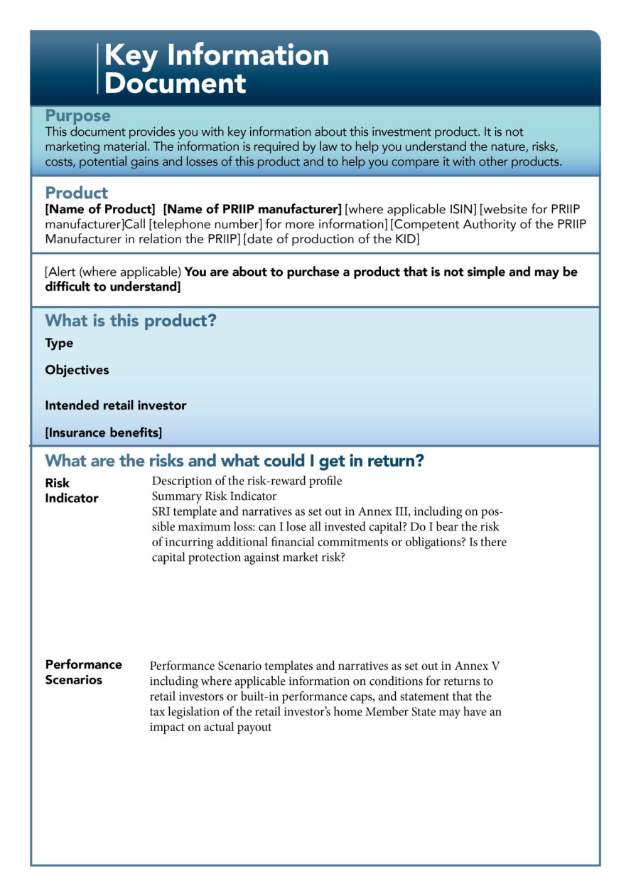
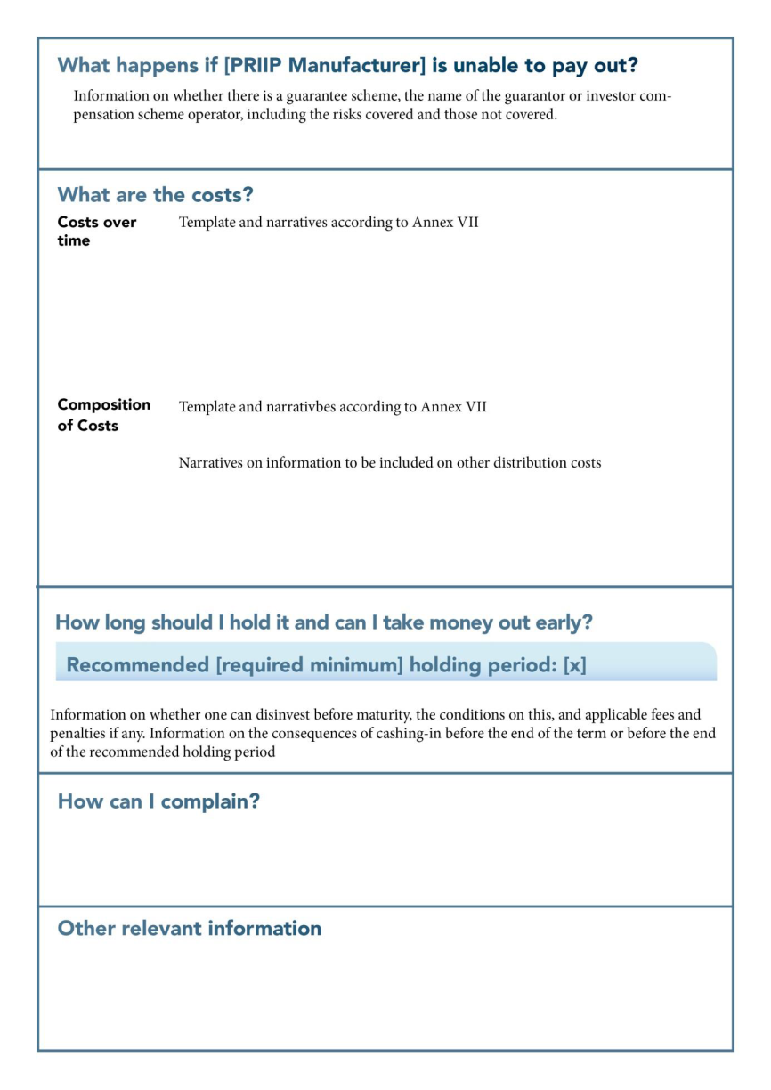
Key information document (KID) for Insurance-based investment products (Priip)

Slide 17
Product-specific information distribution of IBIP (Art 29 Abs 1)
+ KID pursuant to PRIIPs +
Insurance-based investment products & proposed investment strategies
All costs and charges
appropriate guidance and
warnings of the risks
distribution cost of the IBIP
cost of adive, where relevant
how the customer may pay for it
any third party payments
information in aggregated form
cumulative effect on the return of the investment (RIY)
itemised breakdown on demand
disclosure of commission !?

Slide 18
Advice (STATUS QUO)
Mandatory advice
(according to information, demands and needs of the customer, adjusted to the complexity of the contract)
Exploration duties ?!
Adivice based on a fair analysis
B E S T A D V I C E
BROKER
Information,
that
restricted
B E S T A D V I C E
Documentation duties
Information if
Contractual agreement with insurer
AGENT
NO Exclusive Agreement with ONE Insurer
but advice is not provided on a fair analysis
restricted
B E S T A D V I C E
Information if
Exclusive Agreement with ONE Insurer
A D V I C E
duty to provide advice only under certain circumstances
unit- and index linked life insurance
Exploration Duty
Knowledge and experience and financial situation
Duty to provide adequate risk-information
Ausschließlichkeitsbindung mit einem VR
INSURER

Slide 19
Advice (Art 20 & 30)
B u s i n e s s w i t h o u t a d v i c e
(= proposal of contracts)
disclosure of any exclusive agreement
A d v i c e
(= personal recommendation)
MS-Option: m a n d a t o r y a d v i c e
Explanation
why a particular product would best meet the customer´s demands and needs
Information if
A d v i c e b a s e d o n a f a i r a n d p e r s o n a l a n a l y s i s
Analysis of a
sufficiently large number
of contracts available
on the market
Information if
A d v i c e
S U I T A B I L I T Y T E S T
MS-Option: m a n d a t o r y a d v i c e
Suitability Statement
DEMANDS-AND-NEEDS TEST
P e r i o d i c a s s e s s m e n t o f s u i t a b i l i t y
Periodic suitability statement
Record setting out the rights and obligations of the parties
Insurance-based investment products
Periodic Reports
on the services provided
MS-Option
i n d e p e n d e n t („u n t i e d“) A d v i c e
B u s i n e s s w i t h o u t a d v i c e
A P P R O P R I A T E N E S S T E S T
MS-Option
e x e c u t i o n o n l y

Slide 20
Assessment of suitability and appropriateness
(Art 30)
Information whether
A d v i c e
is proviced
knowledge and experience
financial situation including ability to bear losses
investment objectives, including risk tolerance
periodic report contains an updated statement
of how the IBIP meets customer´s preferences
objektives and other caracteristics
assessment of a sufficiently large number of IBIP
sufficiently diversified (type and prodcut provider)
no limitation to procucts issued or provided by entities having close links with the intermediary
Knowledge and experience
Warning if necessary
non-complex FI under MiFiD II and no structure which makes it difficult to understand risks
other non-complex IBIP
initiative of the customer
warning
compliance with conflict-of-interest rules
SUITABILITY TEST
KNOW-YOUR-CUSTOMER PRINCIPLE
Information whether a
P e r i o d i c a s s e s s m e n t
of suitability will be provided
MS-Option
I n d e p e n d e n t a d v i c e
DA by COM
APPRO-PRIATE-NESS
TEST
B u s i n e s s w i t h o u t a d v i c e
but MS-option: mandatory advice
e x e c u t i o n o n l y
MS-Option
EIOPA-GL

Slide 21
Cross selling (Art 24)
Insurance product with ancillary product or service
  as part of a package or the same agreement
  no ban on tying or bundling practices
    information, whether it is possible to buy the different components seperately
      if so, provision of adequate description of different components
      seperate evidence of the costs and charges of each component
  if risk or insurance coverage resulting from agreement or package is different from that accociated with the components taken out separately
    ⇨ description of the way in which interaction modifies the risk or insurance coverage
Insurance product is ancillary to a product or service
  as part of a package or the same agreement
  ban on tying practices ⇨possibility of bying the good or service seperately
  exeptions: investment service, credit agreement, payment account
    ⇨relevant Directives apply
EIOPA may develop guidelines
No ban on multi-risk insurance policies
Demands-and-Needs Test in relation to insurance products
Minimum harmonisation

Slide 22
Conflicts of interests and inducements
  Rules on Remuneration (Art 17 para 3)
  Conflict of Interest and Transparency (Art 19)
    Disclosure of the nature of remuneration of the intermediary
      commission; fee (including amount if payable directly by customer); other type/combination
    Disclosure of the nature of the remuneration of employees of insurers
  Prevention of Conflicts of Interests (Art 27)
  Conflicts of Interests (Art 28)
    Identification and management of conflicts of interests
    Disclosure of general nature and sources as ultima ratio
  Information to customers (Art 29)
    Distribution costs are part of the aggregate costs (para 1)
      itemised breakdown on demand
    Lawfulness of commissions & non-monetary benefits (para 2)
      no detrimental impact on the quality of the service
      do not impair compliance with duty to act in the best interest of customer
General rules
DA by COM
criteria and measures
IBIP
DA by COM
criteria

Slide 23
Inducements
IDD (IBIP) & MiFID II
Ban on Inducements
  MiFID II: independent advice (Art 24 Abs 7 lit b)
  IDD: ban on inducements for advised sales as MS-Option (Art 29 Abs 3)
    in general, IDD does not use the term independent advice
      but only the term advice based on a fair and personal recommendation
      MS-Option: independent/“untied“ advice (but even in that case there is no ban on inducements)
Conditions for permissibility of inducements
  „Ex ante view“
    MiFID II: inducement is designed to enhance quality (Art 24 Abs 9) vs
    IDD: no detrimental effect on service quality (Art 29 Abs 2)
  „Ex post view“
    Inducement does not impair compliance (Art 24 Abs 9 MiFID & Art 29 Abs 2 IDD)
  Disclosure
    MiFID I-DRL: detailed disclosure, including the amount (Art 26)
    MiFID II: detailed disclosure, including the amount (Art 24 Abs 9 & Level 2)
    IDD: disclosure is not explicitly mentioned as a conditon for permissibility (Art 29 Abs 2)
        Only itemised breakdown of aggregate costs on demand (Art 29 Abs 1)
    ABGB (General Civil Law)
      Exception from the general rule of a ban on inducements in case of disclosure (§ 1013)
    MaklerG (Broker Act)
      acceptance of third party payments in the form of a commission is permitted / even default solution
      nevertheless duty to disclose the amount of the commission?

Slide 24
Insurance-related rules in the consumer credit act and the mortgage and real estate credit act
3

Slide 25
Information on costs
Aggregate costs (§ 2 para 5 VKrG)
  include insurance premiums if the conclusion of the contract is a condition for providing the credit at all or at the terms stipulated
If at the time of the conclusion of the credit agreement an insurance contract is concluded or an already existing insurance is required and the consumer as a debtor is obliged to keep the insurance contract during the duration of the credit agreement „vinculating“ and pledging the claims of the contract, the insurance premium is part of the aggregate costs (OGH 7 Ob 44/13s)

Slide 26
Credit agreement with Repayment vehicle
Repayment vehicle
  credit agreement under which payments made by the consumer do not give rise to an immediate corresponding amortisation of the total amount of credit, but are used to constitute capital on a repayment vehicle and under which the credit is redeemed later at least partially from the proceeds of the repayment vehicle
  e.g. endowment policies
Additional pre-contractual information
  a clear and concise statement on the risks involved compared to an installment credit
    especially that such credit agreements do not provide for a guarantee of repayment of the total amount of credit drawn down under the credit agreement, unless such a guarantee is given
  if contract is entered into with or mediated by the creditor
    diagram of past performance of the repayment vehicle
    table of the Costs of the repayment vehicle
      in percentage terms and if possible in absolute numbers

Slide 27
cancellation rights
Consumer Credit (§ 12 VKrG)
  time limit
    fourteen days upon conclusion of the contract
    or the later receipt of contract terms and documentation
Mortgage / real estate credit (§ 13 HIKrG)
  only if consumer delcares his will to conclude the contract within two business days after receiving ESIS or without having received ESIS
  time limit
    two business days upon declaration of will or the later receipt of ESIS and information on withdrawal right
    but no later than one month after conclusion on the contract
Cancellation also applies to residual debt insurances

Slide 28
Cross selling / Tying & bundling
(§ 23 HIKrG)
Prohibition of tying practices
  carve outs:
    payment or savings account
    investment product or private pension product
      if used as additional security for the creditor
      or to accumulate capital to repay or service the credit or to pool resources
Relevant insurance policy related to credit agreement
    e.g. residual debt insurance, fire insurance
  creditors may require consumer to hold policy but
  must accept policies providing equivalent level of guarantee
No ban on bundling practices

Slide 29
Recent cases
attribution of acts and ommissions?
Bank
Mediator
Insurer
damages for misselling?
unlimited cancellation rights?
linked contracts?
life insurance
esp. unit-linked insurance
foreign currency credit
Consumer

Slide 30
ContaCt: Martin.ramharter@bmf.gv.at
The presentation exclusively reflects the personal opinion of the speaker.
Thank you for your attention!

