Slide 1
AILA and AIDA Why?
A presentation to the AILA Conference
Michael Gill,
President of AIDA
18 September 2014

Slide 2
The importance and the relevance
The regional and international dimension of everything
We were birthed in AIDA
Learning from the internationals
International network
Australia giving and receiving

Slide 3
AIDA's National Chapters
Argentina | El Salvador | Kazakhstan | Russia
Australia | Estonia | South Korea | Serbia
Austria | Finland | D.P.R. Korea | Singapore
Belgium | France | Lebanon | Slovakia
Bolivia | Germany | Luxembourg | Slovenia
Brazil | Greece | Mexico | South Africa
Bulgaria | Guatemala | Morocco | Spain
Canada | Honduras | Netherlands | Sweden
Chile | Hong Kong | New Zealand | Switzerland
Republic of China | Hungary | Norway | Tunisia
Colombia | Iceland | Paraguay | Turkey
Costa Rica | Indonesia | Peru | United Kingdom
Czech Republic | Israel | Poland | Uruguay
Denmark | Italy | Portugal | USA
Ecuador | Japan | Romania | Venezuela

Slide 4
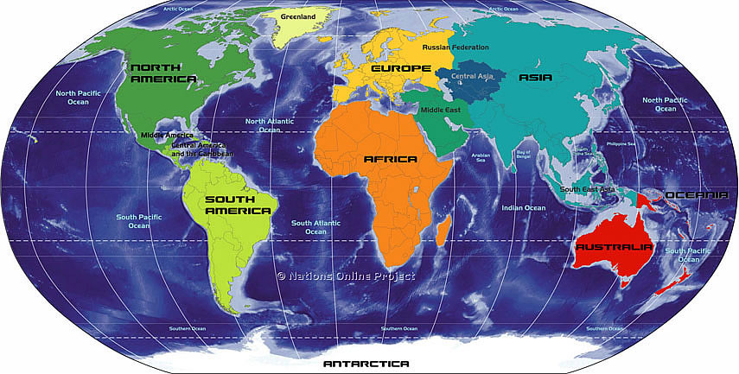
Where is AIDA?

Slide 5
Learning from each other
Law and practice
Needlessly reinventing the wheel
Local uniqueness
The contribution of international experience to our need for change

Slide 6
Take advantage of the opportunities
Know what they are
Choose what suits you best
An increasingly globalised world
The hot topics in Rome
The Working Parties

Slide 7
Working Parties
Accumulation of Claims & Subrogation | Marine Insurance
Civil Liability Insurance | Motor Insurance
Climate Change | New Technologies, Prevention and Insurance
Consumer Protection and Dispute Resolution | Personal Insurance and Pensions
Credit Insurance and Surety | Reinsurance
Distribution of Insurance | State Supervision and Insurance

Slide 8
World Congress
Every four years
Two or three themes:
Host Chapter and Presidential Council
General Reporters
Presentations
Working Party meetings
General Assembly, Presidential Council and Executive meetings
Regional Group meetings
The social side

Slide 9
Unexpected opportunities
Microinsurance
Clinical legal training in Vietnam
University of Economics and Law, Ho Chi Minh City
The insurance laws of Vietnam
Dr Nam Nha Thi Bach

Slide 10
Conclusion
Those of us who have a passion for fair and effective law and an appreciation of the many challenges presented by and to the world of insurance, need no convincing about the value of AIDA.

