Slide 1
The Impact of Climate Change on Insurance
The Day Before Yesterday and The Day After Tomorrow…
Congresso do Comité Ibero Latino-Americano de Direito dos Seguros (CILA)
AIDA Working Party on Climate Change (May 8th 2013)
Pedro Castro Caldas

Slide 2
The Day Before Yesterday…
2

Slide 3
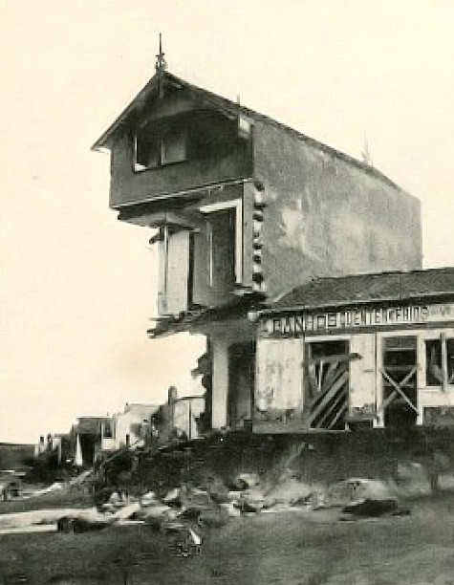
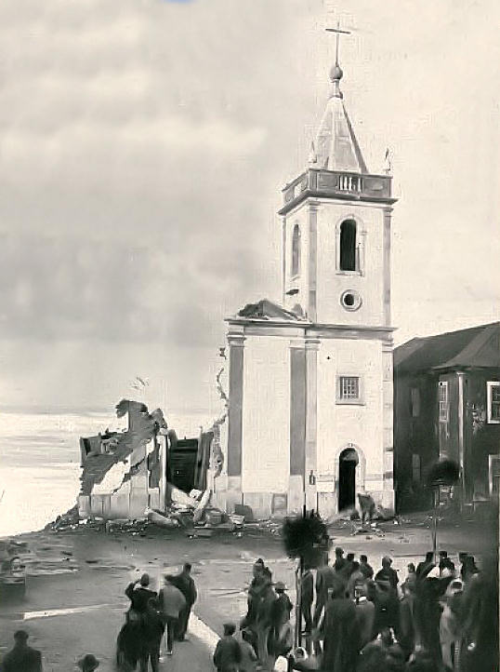
The Day Before Yesterday
The destruction by the sea of Espinho City north of Portugal in 1904
“A indiferença cruel com que o país está assistindo a esse drama emocionante é verdadeiramente espantosa, e basta para definir o estado moral de um povo. Debalde, dessa vila florescente, que as ondas estão implacavelmente devorando, partem clamores de angústia. Dir-se-ia que o rumor das vagas cobre o alarido das vítimas, e que o berreiro dos deputados no Parlamento cobre por sua vez o estrondo das ondas.” (A destruição de Espinho pelo Mar In: "Ilustração Portuguesa", 26-12-1904,)
The cruel indifference with which the country is watching this thrilling drama is truly amazing, and just to set the moral state of a people. In vain, this thriving village, who are ruthlessly be devoured by waves, run cries of anguish. It would say that the rumor of the waves covers the din of the victims, and the howling of the members of Parliament in turn covers the roar of the waves. (In: "Ilustração Portuguesa", 26-12-1904,)
3
Notes:
3

Slide 4
The Impat of Climate Change on Insurance
The past, present and future of Climate Change
The Impacts of Climate Change in Portugal
The Risk Management Issue
Business as usual ?
4

Slide 5
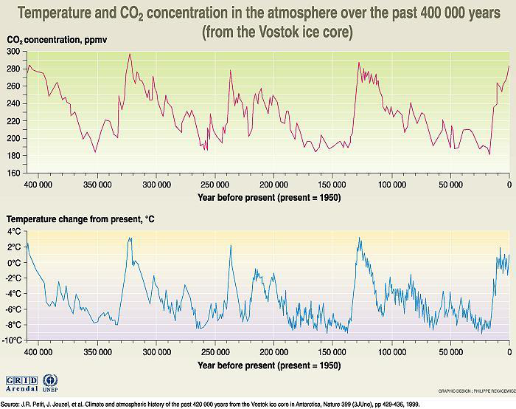
1. Climate Change (the past)
The Earth's atmosphere has varied profoundly since its formation more than 4,000 million years ago.
Over the last 400,000 years the Earth's climate has presented an alternation between cold glacial periods and interglacial periods relatively warm
The climate of the last interglacial 8000 years has been relatively stable providing especially favorable conditions for the development of various civilizations.
5

Slide 6
1. Climate Change (the past)
Despite this stability, in a relatively recent period, known as the Little Ice Age that would have started in the sixteenth century and completed in the first half of the nineteenth century, with minimum temperature in the years 1650, 1770 and 1850, forcing communities to adopt adaptation strategies which are eloquent historical records
.
6

Slide 7
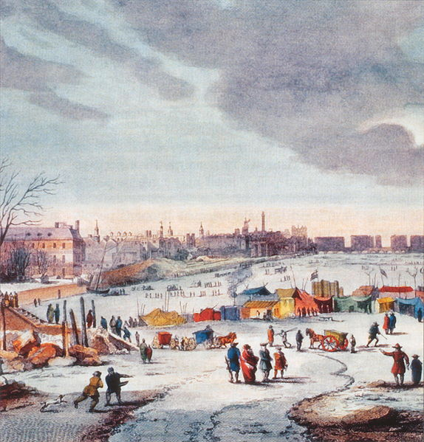
1. Climate Change (the past)
During the Little Ice Age in the sixteenth and seventeenth Century the Thames in England froze several times, with the first "Frost Fair" on record occurred in 1608 in London, with detailed description of "Frost Fair" from 1683-84 with carriages circling on the ice from Westminster to the Temple with many attractions on the ice.
In Iberia Peninsula the sixteenth and seventeenth centuries were characterized by frequent freezing of rivers and major floods in almost all basins, although periods of continuous rains were very sparse and almost nonexistent in the seventeenth century, having occurred a gradual desertification of the Meseta.
.
7

Slide 8
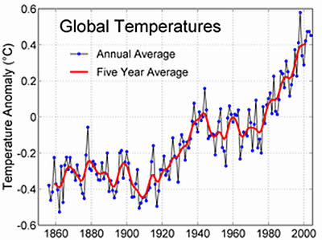
1. Climate Change (the present)
Since the beginning of the XIX and XX particularly from the last decade, it has become clear a tendency of heating wherein the last 5 years warmer 150 years have been observed over the last decade. The occurrence of extreme heat, with great economic and social impact, forced people to look at global warming as a problem to require monitoring and planning.
8

Slide 9
1. Climate Change (the future)
There is a broad scientific consensus that climate change, caused by the intensification of the greenhouse effect due by some human activities, will go worsen over the century XXI, being necessary to adopt adaptation measures that can minimize the adverse effects of climate change and avoid negative consequences for populations and economies ...
9

Slide 10
2. Sectorial Impacts of Climate Change in Portugal*
On human health and tourism
On agriculture
On forests
On biodiversity
On energy
On water resources
On coastal zones
On fisheries
* Source : Project SIAM II (Climate Change in Portugal; Scenarios, Impacts and Adaptation Measures)
10

Slide 11
2. Sectorial Impacts of Climate Change in Portugal
On human health and tourism: among the adaptation measures for mitigation of heat stress, is highlighted the additional need of air conditioning and as well the development of projects for buildings that incorporate features that reduce the heath load
Climate change may eventually provide more favorable conditions for the development of infectious diseases
11

Slide 12
2. Sectorial Impacts of Climate Change in Portugal
On agriculture, forests & biodiversity : except pasture and fodder, all cultures will suffer a decrease in productivity.
It is expected that the forest could disappear from currently more arid areas increasing the risk of fire in a warmer and drier climate.
The results of the evaluation of the impact of climate change show a marked change in the structure and composition of vegetation with consequences for biodiversity.
It is expected a greater access of nutrients in water with increasing symptoms of eutrophication.
12

Slide 13
2. Sectorial Impacts of Climate Change in Portugal
On energy : with the new climate scenarios the reduction of energy needs for heating and sanitary water heating especially in the cold months, is more than compensated the needs for HVAC in the warm months.
Regarding the frequent technological developments in the energy sector it is recommended the rapid development of opportunities to enhance the positive impacts (namely with renewables) and seek to adapt to the negative impacts (mainly in energy demand)
13

Slide 14
2. Sectorial Impacts of Climate Change in Portugal
On water resources: climate models suggest an increase in precipitation in the North and decrease in the Center and South of the country estimating an increased frequency of intense rainfalls increasing the magnitude and frequency of episodes of flooding.
14

Slide 15
2. Sectorial Impacts of Climate Change in Portugal
On coastal areas it is foreseen the elevation of sea level recommending the adoption of measures to improve efficiency of operations for regular cleaning of water lines, ditches and other drainage devices surface water and increasing the efficiency of the legal instruments forbidding the occupation of flood prone areas, such as floodplains.
15

Slide 16
2. The Impacts of Climate Change in Portugal (causes and challenges)
The global warming observed over the last 50 years probably by emissions into the atmosphere of greenhouse gases (GHGs) led to the elaboration of the National Low Carbon Roadmap (RNBC) * with the objective of "study of the technical and economic feasibility of emission reduction trajectories of greenhouse gas emissions in Portugal, leading to a low carbon economy by 2050“; pointing "strategic guidelines for the various sectors of activity”
(*) National Low Carbon Roadmap (RNBC) was determined by resolution of the Council of Ministers n. º 93/2010 of 26 November. The RNBC aims to study the technical and economic feasibility of trajectories for reducing emissions of greenhouse gases in Portugal, leading to a saving of low carbon by 2050.
16

Slide 17
2. The Impact of Climate Change on Insurance
"Now that the insurance market began to pay more attention to climate change, the question is what can be done to prevent it from becoming a problem .... how the insurance market addresses the issue of climate change is vital, and essential to the health of the economy "
(FullCover nº2/2010, The Challenge of Climate Change / Mapfre "Risk Management and Safety ” nº 97)
17

Slide 18
3. Risk Management and Insurance
Risk Management : set of coordinated actions to control and direct the organizations, taking into account the uncertainty and its effect on goals through :
risk identification (identification of sources of risk, risk events and their possible consequences)
risk analysis (analysis of the causes and origin of risks and the likelihood that they will occur)
risk assessment (deciding which risks need to be treated)
risk treatment (Determination of strategies to mitigate or control risks)
18

Slide 19
3. Risk Management and Insurance
Identified, analyzed and evaluated the sectorial risks from climate change, strategies to mitigate or control risk, pass for the adoption of procedures of safety & security, containment and mitigation and also of transfer to insurance of property, personal and liabilities risks.
Such transference of risk will impact :
Property Insurance namely on flooding exposures and fire exposures namely on forests
Personal Insurance namely on Healthcare exposures
Liabilty Insurance namely on lack of initiative by authorities and others to take action to prevent material and personal damages due to climate change.
Crops Insurance namely due to change in the structure and composition of vegetation with consequences for biodiversity
19

Slide 20
3. The flood risk management in the context of climate change (A tool for evaluation and risk analysis)
The flooding risk in Portugal:
Flood risks either sea or river, gained increasing importance in recent decades, especially in urban areas, due to increased human intervention in flood zones and extreme precipitation events in short periods of time.
EU Directive 2007/60/EC of 23 October 2007 (transposed into Portuguese law by Decree Law No. 115/2010 of 22 October) established a framework for the assessment and management of flood risks, that EU Members should adopt, assuming the need of "... preparation of flood hazard maps and flood risk maps showing the potential adverse consequences associated with different flood scenarios ...".
20

Slide 21
3. The flood risk management in the context of climate change A tool for evaluation and risk analysis
This project aims to investigate the vulnerability to flooding of the territory, in the context of climate change expected
The project also aims to create a vision in the medium and long-term on the vulnerability to flooding of Portuguese territory, thereby reducing the society exposure to these phenomena
Thus, the project will produce, for Portugal, flood hazard maps and flood risk in the short, medium and long term, taking into account climate change scenarios. Will be identified and characterized the potential impacts / damage to the areas considered most vulnerable
21

Slide 22
3. The flood risk management in the context of climate change A tool for evaluation and risk analysis
The study area is divided into two scales: (i) a macro scale for mainland Portugal where will be identified flood areas and (ii) a scale-local to the regions considered vulnerable based on the criteria of likelihood of flooding and risk of flood, defining the latter as the combination of the probability of flooding with the potential adverse consequences to human health, the environment, economic activities and cultural heritage.
In Portugal, where this information does not yet exist in a structured and enough detailed way, floods have been responsible for loss of property and on economy, and are expected further significant changes in rainfall patterns, frequency and intensity of extreme weather and extreme weather events such as intense rainfall over short periods.
22

Slide 23
4. Business as usual ?
urge to adopt Adaptation Strategies (*), developing new communities of interest and sustainable business, with assumed behaviors of Social Responsibility (**) and corporate sustainability,
necessarily sharing and regulating global interests, taking into account the expectations of stakeholders, in accordance with the law and consistent with international norms of conduct,
thus contributing to the sustainable and efficient management of, energy, land and water, and waste, and for the defense of biodiversity, science ,
technology can provide invaluable contributions to the development and innovation of new solutions.
(*) the "adaptation strategy" ("Adaptation Strategy") is the name adopted by the EU for phased adaptation to the impact of climate change supplement the actions of Member States in this field
(**) Guide to Social Responsibility (ISO 4469-1 26000/NP): responsibility of an organization for the impacts of its decisions and activities on society and the environment, through transparent and ethical conduct.
23

Slide 24
4. The announced end of the Business as usual
The beginning of the end of business as usual due to climate changes, requires transition behaviors opening up new horizons and challenges of emerging risks mutualisation, rethinking and regaining the good fundamentals of insurance activity, on the assessment, prevention and sustainable transfer of risks as support to adapt to new adversities of the present and future with the existing information available regarding the catastrophic coverage's (NATCATs) and developing risk management capabilities through solutions and models appropriate to the reality of each risk exposure in concrete.
24

Slide 25
The Day After Tomorrow…
25

Slide 26
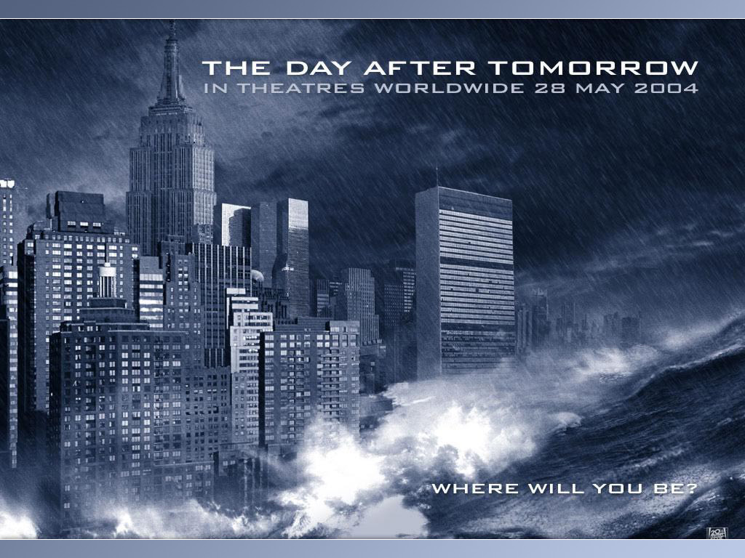
Poster promoting the 2004 film from 20th Century Fox sci-fi apocalyptic directed by Roland Emmerich that depicts the effects of global warming
26

Slide 27
Sources : Estudo de Avaliação da Situação Ambiental e Proposta de Medidas de Salvaguarda para a Faixa Costeira Portuguesa (J. M. Alveirinho Dias) / Alterações Climáticas em Portugal Cenários,Impactos e Medidas de Adaptação (projeto SIAM II F.D.Santos; P.Miranda) / ISO 31000 / Projeto CIRAC/ River Thames frost fairs (Wikipedia) /FullCover nº2/2010, O Desafio da Mudança Climática (Mapfre “Gestão de Riscos e Segurança” nº 97)
27

