Slide 1
HILA-AIDA Summit Athens 2014
Prof. Dr Dr Kostas Christodoulou
Athens University Law School
Motor Insurance
The Recoverability of the Damages of Third Parties Insured
Especially as Successors of the Culprit

Slide 2
Prof. Dr Dr Kostas Christodoulou
RRule 'All-or-Nothing

Slide 3
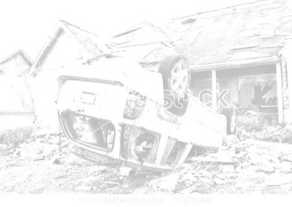
Prof. Dr Dr Kostas Christodoulou
EU Law Gr Law Gr Courts
Personal Injuries √ √ √
Property Injuries √ √ √
Third-Party PELoss X √ √
Non-Pecuniary Damage X √ √

Slide 4
Prof. Dr Dr Kostas Christodoulou
Might the Relatives be Insured Third Parties?

Slide 5
Prof. Dr Dr Kostas Christodoulou
Might the Relatives be Insured Third Parties?
Before the Death
of
the Culprit Holder of the Insurance
EU Law Gr Law Gr Courts
Personal Injuries √ √ ?
Other Damages X ? ?

Slide 6
Prof. Dr Dr Kostas Christodoulou
Might the Relatives be Insured Third Parties?
After the Death
of
the Culprit Holder of the Insurance
Extinction of the Unpaid Insurance Claims due to Merger
or
Recourse Liability for the Collection of the Insurance Claims

Slide 7
Prof. Dr Dr Kostas Christodoulou
Result
No Protection of the Relatives,
even for Bodily Injuries

Slide 8
Prof. Dr Dr Kostas Christodoulou
Would That be a EU-like
Motor Insurance Law?

Slide 9
Prof. Dr Dr Kostas Christodoulou
Many Thanks for your Attention

