Slide 1
Giacomo Pongelli
Professor of Private Law
University of Milano - Bicocca
AIDA RIO 2018
XV World Congress
- Rio de Janeiro -
October 2018
giacomo.pongelli@unimib.it

Slide 2
Automated cars and new technologies impacts on italian and european motor insurance

Slide 3
1. Introduction 2. Autonomous and semi-autonomous vehicles 3. Civil liability and motor insurance related to AVs 4. Product liability issues and european regulation 5. Conclusion

Slide 4
1) Introduction
New technologies impact on different fields
Mobility: smart roads, smart cities, autonomous and connected vehicles
Sharing mobility

Slide 6
Almost 90% of traffic accidents are to be attributed to human failure. In EU around 50.000 people are killed in traffic accidents every year. Huge economical loss.
2) Autonomous and semi autonomous vehicles
Around 90% of traffic accidents depend on human failure
Reduce human impact to reduce damages
Autonomous vehicles

Slide 7
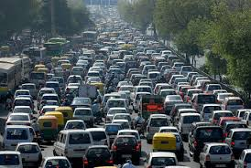
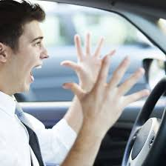
Commuters waste a full week of their lives in traffic each year.

Slide 8
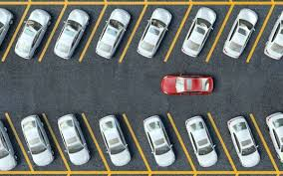
Waste of 17 hours a year
searching for parking
spots

Slide 10
We already are on the path to Full Automation
IoT (Internet of Things): Connected vehicles and internet based services
ADAS (Advanced Drivers Assistance Systems) are always more common on new cars. Some of them became compulsory (ABS, ESP…)
Even the most advanced ADAS still need the physical presence and attention of a human driver behind the steering wheel
Human driver is not the only one to determine a vehicle behaviour on the road
Higher safety level on public roads

Slide 11
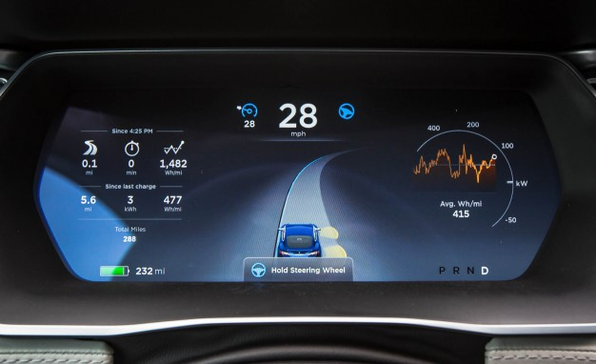

Slide 14
Principal issues related to AVs diffusion:
Authorization to circulate on public roads (standards)
Personal Data Protection/Cybersecurity
Liability in case of accidents
Motor Insurance

Slide 15
3) Civil liability and motor insurance related to AVs
Automation can reduce human errors, but in some circumstances damages cannot be avoided
When an accident occours, who pays for the damage compensation?
The presence of an automated choice affects the process of determining the event and the effect of the choice.
Analysis of the interaction between man and machine in causing the event. (Causal nexus)
Machine error doesn’t always depend on a production error. ‘AI’ products can take a wrong choice even when not defective.

Slide 16
Art. 2054 Civil Code – CIRCULATION OF VEHICLES
1. The driver of a vehicle that is not guided by rails is liable for the damage caused to persons or to property by operation of the vehicle unless he proves that he did all that was possible to avoid the damage.
2. In the case of collision of vehicles, it is presumed, until proof to the contrary is offered, that each driver contributed equally toward causing the damage suffered by each vehicle.
3. The owner of the vehicle, or in his place the usufructuary or purchaser with reservation of ownership, is liable jointly and severally with the operator of the vehicle, unless he proves that the vehicle was being operated against his will.
4. In any case, the persons indicated in the preceding paragraphs are liable for damage arising from defects in the manufacture or maintenance of the vehicle.

Slide 17
AVs lability could be addressed to many different subjects:
Owner/user of the vehicle
Producer of the vehicle or the Producer of the installed software and automation algorithms
Managers and collectors of information and data shared by the vehicles (smart cities, smart cars)
Suppliers of car mantainance and services

Slide 18
Protection of victims of traffic accidents:
Strict liability
No-fault insurance
Guarantee fund
?
?
?
There is the need to preserve one of the most important function of tort law:
DETERRENCE

Slide 19
4) Product liability issues and european regulation
European Union:
Need for a common legislative framework
Motor Insurance Directive 2009/103/EC
Product Liability Directive 85/374/EEC
(2018 European Commission Report)

Slide 20
The Product Liability Regime
The manufacturer has to compensate persons suffering injury or damage to private property from defects in a product.
The software installed in an AV can be considered a product?
In case of an accident can it be considered defective?
Defect: «A product is defective when it does not privide the safety which a persons is entitled to expect»
Risks defence: «The state of scientific and technical knowledge at the time when he put the product into circulation was not such as to enable the existence of the defect to be discovered»

Slide 21
UK – Automated and Electric Vehicles Act (2018)
The insurer is always liable for the damage. The victim can be the driver as well as any other passenger or road user.

Slide 22
Germany: Road traffic Act (Straßenverkehrsgesetz)
- Amended in july 2017 -

Slide 23
Driver is not allowed to turn his attention completely away from the traffic.
Automation must be overridden or deactivated at any time by the vehicle operator.

Slide 24
4) Conclusion
Future is not so far…
ARE WE GOING TO BE READY?

Slide 25
Bibliography
S. Landini, Automated choice, causation and civil liability, in Insurtech (directed by K. Noussia and P. Marano), being published.
A. Di Rosa, Auto a guida automatica: profili assicurativi e di responsabilità civile, in www.altalex.com, 2018.
ANIA, Smart Roads, veicoli connessi ed autonomi, Discussion Paper October 2017.
N. Bevan, R. Merkin, K. Noussia, Driverless Vehicles – Where are we wrong?, in Connected and Autonomous Vehicles: The future?, House of Lords UK, 2016.
EU Parliament, Civil Law Rules on Robotics, Resolution of 16 February 2017.
EU Commission, On the road to automated mobility: an EU strategy for mobility of the future, Brussels COM(2018) 283 final.
EU Commission, Evaluation of Council Directive 85/374/EEC on the approximation of laws, regulations and administrative provisions of the Member States concerning liability for defective products, Brussels, 2018.
M. Channon, Autonomous Vehicles and Legal Effects: Some Considerations on Liability Issues, in DIMAF Review, 2016, p. 33
A.C. Nazzaro, Macchine intelligenti (smart cars): assicurazione e tutela della privacy, in DIMAF Review, 2018, 60 ss.

