Slide 1
"Motor Liability and Boat Liability: damages, compensation, insurance. A comparison".
Sara Landini

Slide 2
Marine Insurance
Marine insurers offer a wide range of coverages.
Typical causes of loss that are covered include: weather-related perils such as wind, rain, hail, lightning and wave action; fire; loss or damage caused by theft or vandalism; and collisions with docks, submerged or floating objects or other boats.
May be liability coverage is the most important. Boat owners may also be responsible for any containment and clean-up expenses resulting from oil pollution or contamination caused by their vessel.

Slide 3
In your country what losses are covered in automobile or boat-owners insurance?
In many countries automobile or boat-owners insurance coverage is similar. In Italy for instance the Act 990/1969 (now included in insurance code – legislative decree) provides common rules for mandatory motor insurance and mandatory boat insurance.

Slide 4
Italian Insurance Code
NOT ALL DISPOSITIONS ON MANDATORY MOTOR INSURANCE CONTAINED IN THE ITALIAN INSURANCE CODE ARE RELEVANT IN CASE OF BOAT LIABILITY.

Slide 5
Some Italian Cases
Justice of the Peace of Sorrento (Judgement 15 July 2009) and Justice of Peace of Pozzuoli (Judgment 21 June 2010) affirm that:
According to article 123 insurance code norms on mandatory motor insurance operate in case of boat liability only in case of personal injuries.
In case of boat liability no direct action of the victims and no direct reibursement of the insured party are provided. (With regard to the direct action see also Supreme Court 24 april 2007, n. 9516; Supreme Court 18 June 2002, n. 8816; Supreme Court 18 november 1994, n. 10156).

Slide 6
Boat Liability and Personal Injuries
Artt. 138 e 139 Ins.code, about injuries to the body of a person, are applicable in case of boat liability as well.

Slide 7
Personal Damages
Article 139 provides the parameters for the quantification of the amount of damages in case of minor injuries.
The parameters for determining personal injury as a result of non-minor injury (pursuant to article 138 of the Insurance Code) are still to be determined by the Government.
By the moment for the purposes of quantifying such damages, reference must be made to the tables of criteria applied by the Court of Milan, recently recognised as generally applicable by the Court of Cassation (judgments no. 12408/11 and 19376/12).

Slide 8
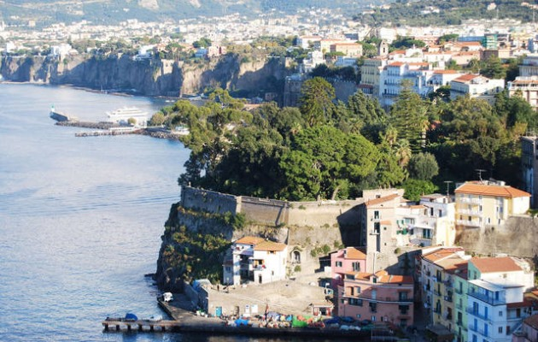
Boat liability, Motor liability,
Frauds

Slide 9
Boat liability, Motor liability,
Frauds
On October 2009 in Sorrento 4 men sank a 13 meters ship faking an accident in order to gain money from the Insurance company.
By the moment the 4 men are under arrest.

Slide 10
We’d like to stimulate a comparison between liability for motor vehicle (cars) and boats or aircraft
(1) In your country is boat liability insurance mandatory?
(2) In your contry is there a no fault liability system, or should liability be proven?
(3) Is compensation is limited and how?
(4) is there any difference between bodily injury and property damage?

