Slide 1
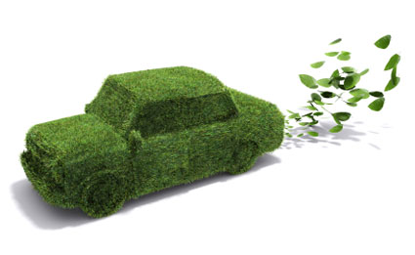
Green Car & Insurance
Motor Insurance Working Group
Chairwoman: Prof. Sara Landini, Italy
Vice Chairwoman: Adv. Peggy Sharon, Israel
Sydney, 18 September 2013

Slide 2








Pay as you Drive?
Hungary
PAYD models exist, but
mainly rejected by
as unnecessary + owing to privacy issues
Large insurers – not introduced PAYD.
Two cos. (Sony + Zurich) have done so, based on different self-reporting models + found popular.
Germany
Japan
X
Switzerland

Slide 3





Pay as you Drive?
2 insurers provide- one on self-reporting basis; one using telematics/black box, now also with smartphone app registering kms and speed.
Holland
Yes, but concerns re privacy, leading to consultation paper ahead of possible ruling.
Italy
Many insurers now provide: different terms/bases. Growth in usage, but extent of importance uncertain.
UK
Insurers do provide on self-reporting and telematics/black box basis. Take-up of latter slow- limited control to date and privacy concerns.
Belgium

Slide 4









Pay as you Drive?
?
A no. of insurers provide: various discounts, terms, forms of penalty if mileage limit exceeded.
In use for 10 yrs. Many cos. Different bases. 2/3 US States permit. Represent <1% of all MV covers at present. NAIC predict 20% in 5yrs, but doubts – costs/privacy issues.
Renault Argentina promotes a sustainable driving programme, “Eco-driving”, but not actively supported by insurers in products.
Not a PAYD scheme, but reflecting reduced mileage, reduced premium for religious in Israel not using cars on Saturdays.
Australia
U.S.A
Argentine
Israel
Notes:
בישראל ישנה הנחה בפרמיה לאנשים דתיים שאינם נוסעים בשבת, אבל לא משיקולי איכות הסביבה.

Slide 5
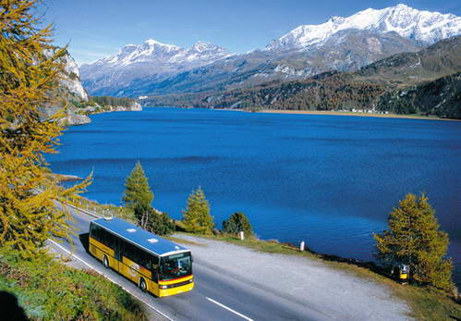
Incentives for the use of Green Cars
Insurance policies provide an extra discount (3%) on premium for electric or
hybrid car owners.
Car-pooling/sharing provisions. Carbon offsetting.
A. Premium/other provision
Hungary
Some insurers have premium discounts on eco cars.
“Eco discounts” of up to 40% if gas/electric/hybrid subject to
capacity/fuel consumption etc – discount if rail/bus season ticket for commuting; carbon offsets; cover for car pooling/sharing.
Germany
Japan
Switzerland
Insurance policies provide an extra discount on premium for electric or hybrid car owners.

Slide 6
Incentives for the use of Green Cars – Premium/other provision (cont.)
Insurance policies provide an extra discount on premium for electric or hybrid car owners. Eco-friendly repair network. Car pooling/sharing provisions. Carbon offsetting.
Holland
“Eco driving policy” and car-pooling/sharing provisions.
Italy
Insurance policies provide an extra discount on premium for electric or hybrid car owners. Carbon offsetting. Eco-driving policies. Eco-friendly repair network. Car pooling/sharing provisions.
UK
Discount if rail/bus season ticket for commuting/car-pooling/sharing options/savings.
Belgium

Slide 7
Incentives for the use of Green Cars – Premium/other provision (cont.)
PAYD likely to reduce premiums by up to 30%, but costs issues and unsuitability for some insureds limits use. Carbon offsetting.
Allianz promote a forest –saving scheme when selling policies…
Lower premiums for smaller fuel-efficient cars. Carbon offsets.
Australia
U.S.A
Argentine
A reduction of 10% on the premium for vehicles of higher grade of the Green Index. Carbon offsetting.
Israel

Slide 8

Incentives for the use of Green Cars
B. Taxation
Special incentive for 1st time registered electric cars: 10yrs exempt from vehicle tax
Hungary
Germany
Japan
Ministry of Land, Infrastructure, Transport & Tourism offers tax incentives to car buyers of eco-friendly vehicles, e.g. Toyota Prius standard model (17% purchase tax rate) versus eco Aqua standard model (7%).
Switzerland

Slide 9
Incentives for the use of Green Cars - Taxation
(cont.)
Registration tax based on price/CO2 emissions. Lowest two bands exempt. Low-emitting diesel and other fuels exempt from circulation tax. Electric vehicles exempt from both.
Holland
Electric vehicles exempt from annual circulation tax for period of five years from date of first registration. Thereafter, 75% reduction of tax rate applying to petrol vehicles in many regions.
Italy
Annual circulation tax for cars registered after Mar 2001 based on CO2 emissions. £0 for lowest to £475 pa highest emitters. Since Apr 2010 a 1st yr rate varies from £0 to £1,030. Discount for alternative fuels. Company cars subject to similar scales for personal income/benefit tax . Surcharge for diesel and exemptions from taxes for electric vehicles.
UK
Premium paid to purchasers of electric/plug-in hybrids of low emissions of £5k or £8k.
Belgium
Tax incentives for car owners to reduce CO2 emissions (via electric, hybrid, low emission vehicles)

Slide 10
Incentives for the use of Green Cars - Taxation
(cont.)
? Reduced business fuel tax credits equivalent to carbon price, not applicable to passenger and light commercial vehicles. Other? Coalition plans?
? Being established.
The reverse. Import restrictions (and luxury tax) on vehicles like the Toyota Prius restrict affordability/use of such vehicles to only 248 units sold in Argentina (of 5m worldwide). Measures to reduce import duty on low emissions cars cancelled soon after implementation in 2010.
Australia
U.S.A
Argentine
The law on green Taxation – discount on tax.
Israel

Slide 11
Legal Instruments for Green Car use
Hungary
Germany
Japan
Switzerland

Slide 12
Legal Instruments for Green Car use
Holland
? Govt has authority to make laws, but presently preferring to operate by way of “gentlemen’s agreements” with sectors/industries to help achieve emissions commitments.
New incentives scheme being considered/introduced.
Significant amounts of legislation in respect of emissions targets obligations of auto manufacturers and others , clean air legislation and provision for scrappage schemes, local authority policies etc . ABI guidelines re PAYD policies.
No legislative or regulatory measures yet to impose compulsory provisions re PAYD practices, but Belgian Privacy Cmmssn investigating.
Italy
UK
Belgium

Slide 13
Legal Instruments for Green Car use
? In 2010 election pledge to tighten emissions standards for light MVs to incl. passenger cars, SUVs etc to reduce av. new light vehicle emissions level of 213gCO2/km (cf. EU 140gCO2/km), but post-election
Being established.
Australia
U.S.A
Argentine
Tax reductions, The Class Actions Law, Clean Air Law, 2008,
The Law of Prevention of Environmental Hazards, 1961.
Israel

Slide 14
Thanks!

