Slide 1

Association Internationale de Droit des Assurances
International Insurance Law Association
Associazione Internazionale di Diritto delle Assicurazioni
Internationale Vereinigung Versicherungsrecht
Asociacion Internacional de Derecho de Seguros
JOINT MEETING OF CLIMATE CHANGE AND MOTOR INSURANCE WORKING PARTIES
SYDNEY - WEDNESDAY 18 SEPTEMBER 2013
Climate Change, Motor Vehicles and Insurance – Taming the Beast?
Overview of Motor Vehicles, Manufacture, Insurance
and Climate Change
Tim Hardy
AIDA Climate Change Working Party Chair
Vice President, British Insurance Law Association, UK

Slide 2
Overview of Motor Vehicles, Manufacture, Insurance and Climate Change:
The Nature of the Beast?
“Climate Control as Standard”
Blessing and curse of the private MV is obvious.
Act of driving is the regular activity of the average person to make greatest contribution to man-made climate change.
Three-quarters of all transport emissions come from road vehicles. Personal MVs consume more GHGs per passenger/km than any other surface mode of transport.
MV travel accounts for 15-30% of total trips in developing world. 50% in Western Europe. 90% in the United States.
For each gallon of gasoline consumed by MVs nearly 20lbs of CO2 estimated to be released into atmosphere. In US alone every 1m gallons of gasoline releases c.10k CO2 tonnes at a rate of 420m gallons or 8bn CO2lbs per day.
Heavy and continuing CO2 emissions levels from MVs in developed world reflects how economic development and transport are inextricably linked: development increasing transport demand; availability of transport stimulating development.
Number of MVs continues to rise and in developing world at still faster rate. As of 2010 estimated more than one billion MVs in use and some predict 2 billion by 2020.

Slide 3
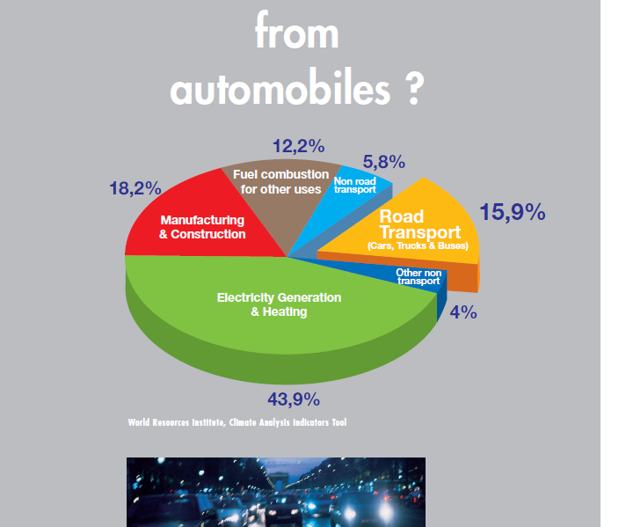
Overview of Motor Vehicles, Manufacture, Insurance and Climate Change:
Significance of Motor Vehicles in Emissions Reduction?
Q: Proportion of world’s GHG emissions attributable to motor vehicles?
A: Not as consistently or easily found as expected, but most authoritative estimates indicate:
  approx 16% of global man-made CO2 emissions (but higher in some parts)
  proportion likely to remain constant as vehicles/usage rise globally offsetting progress in fuel consumption
  OICA – International Organisation of Motor Vehicle Manufacturers
  WRI - World Resources Institute

Slide 4
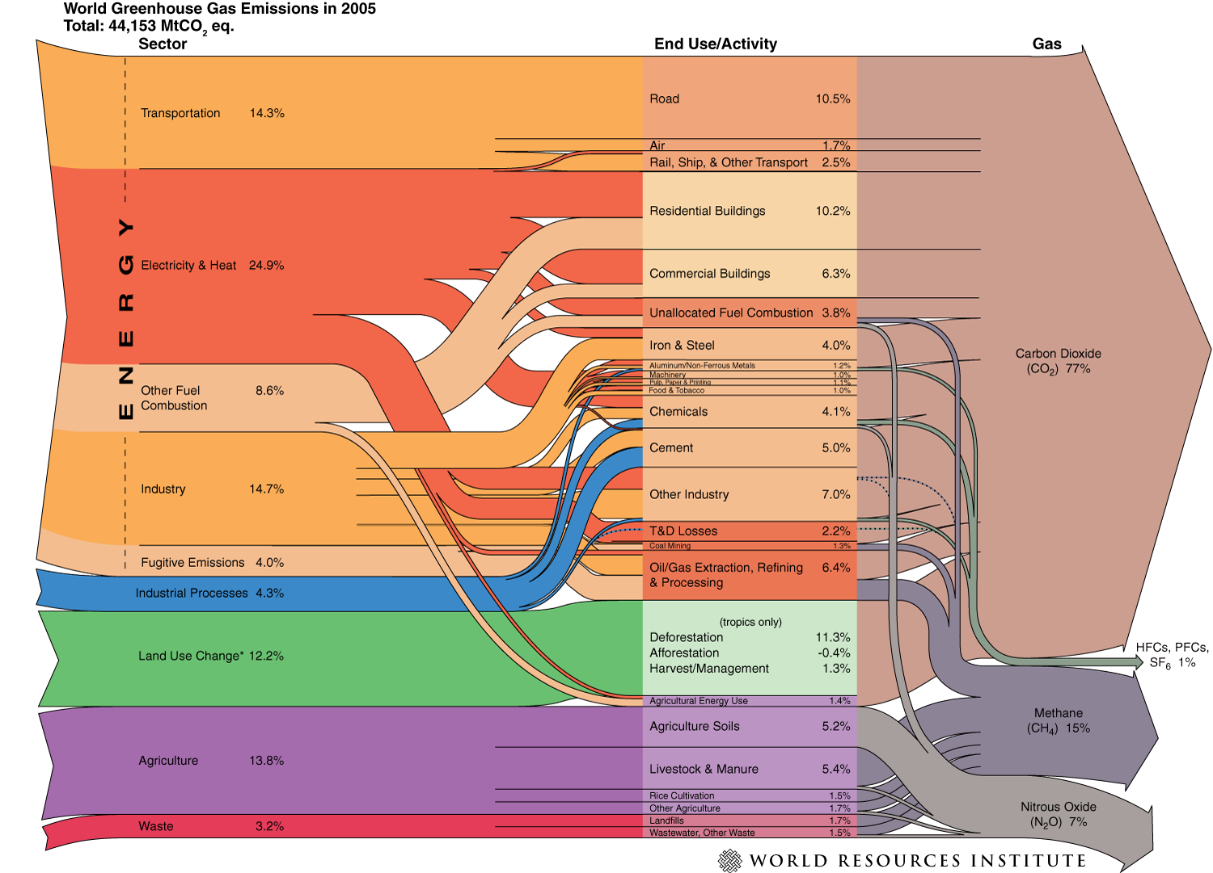
Overview of Motor Vehicles, Manufacture, Insurance and Climate Change:
Establishing Significance of Motor Vehicles in Emissions Reduction

Slide 5
Overview of Motor Vehicles, Manufacture, Insurance and Climate Change:
Where in the world does one begin?
* Leading countries by motor vehicle production:
Trends:
Dramatic fall in production levels in 2009 following 2008 financial crisis has now been followed by record 5% rise in world production in 2012.
Sharp discrepancies between regions – Asia leading with 43.7m units in 2012, Americas 20m, EU less than 20m.
Sales for 2012 nearing 82m globally seeing increases throughout China, India, Japan, S Korea. Also, NAFTA, Russia/Turkey/other European countries and Africa. EU27 showing decline.
China now accounting for 23% of worldwide sales with global rise of 3% forecast for 2013, despite bleak prospects for EU.
CO2 emissions from motor vehicles:
Growth in no. of vehicles in China had been predicted over next 20 yrs to see annual rise of 13% pa and nearly doubling every 5 yrs and India to rise by c.7% pa, but % share still small.
Their large vehicle fleets make developed countries responsible for a commensurately large proportion of global emissions. (In US transport accounts for nearly 25% of country’s emissions and in EU approx 20%.)
On some projections by year 2030 OECD countries would still account for 50%- 60% of global motor vehicle emissions despite representing only about 16% of the world’s population.
            * OICA statistics
Rank | Country/Region | 2012 (m) | 2011 (m)
1 | China | 19.27 | 18.42
- | EU | 16.24 | 17.70
2 | US | 10.33 | 8.65
3 | Japan | 9.94 | 8.40
4 | Germany | 5.65 | 6.31
5 | S Korea | 4.56 | 4.66
6 | India | 4.15 | 3.94
7 | Brazil | 3.34 | 3.41
8 | Mexico | 3.00 | 2.69
9 | Thailand | 2.48 | 1.46
29 | Australia | 210k | 224k
World totals: |  | 84.14 | 80.10

Slide 6
Overview of Motor Vehicles, Manufacture, Insurance and Climate Change:
Where in the world are the worst levels of CO2 emissions from road transport?
*CO2 Emissions – road transport (2010)
Rank | Country/Region | mill tonnes
1 | US | 1,401
- | EU | 848
2 | China | 395
3 | Japan | 201
4 | Brazil | 148
5 | Mexico | 147
6 | India | 145
7 | Germany | 141
8 | Russia | 140
9 | Canada | 140
18 | Australia | 69
World totals: |  | 4,972
Similar to the manufacturing table at present, but regional shift expected to see OECD 60% share diminish as growth in energy consumption rises to be greatly exceeded by those in China, India etc.
Even if energy use in mature market economies slows in contrast, allied in some countries with high fuel taxes and greater fuel efficiencies, assumptions are that emissions will continue to grow even there.
In the EU transport remains the only major sector where emissions are continuing to rise.
Projections suggest that global road transport energy use and emissions could be up to 75% higher by 2030 without major changes in both transport policy, vehicle design and use and other initiatives.
  * IEA (2012 Edition) based on latest 2010 figures, with emissions from manufacture etc added to fuel combustion emission figures

Slide 7
Overview of Motor Vehicles, Manufacture, Insurance and Climate Change:
How to bring about emissions reductions (1)?
  Agreement to Reduce Emissions and Setting of Targets
  Promotion of carbon offsets as part of contractual bargain (by manufacturers, insurers, others)
  MV Design and Technology → Fuel efficiency
      More aerodynamic designs
      Lighter materials/increased engine efficiency
      Maintaining efficiencies throughout natural lifespan of vehicle
  Manufacturing and Repairs Process
      Reduction in emissions during manufacture to reduce “cradle to grave” footprint
      (“tread mark”?) of MV and insurers keen on permission to recycle parts for repairs/scrappage.
  Evolution of New Types of Vehicle/Fuel use
      Diesel/petrol → hybrid
      Plug-in hybrids
      All-electric vehicles
      Biofuels
      Hydrogen
  Eco-driving: more economic/efficient use of the MV
  Reduction of VMT (“Vehicle Miles Travelled”)

Slide 8
Overview of Motor Vehicles, Manufacture, Insurance and Climate Change:
How to bring about emissions reductions (2)?
Reduction of VMT (“Vehicle Miles Travelled”)
Role of governments and others, not the MV manufacturers
Public transportation policies and urban design (of existing and future cities)
Encouragement of changes in transport use/practices by taxes, quotas/trading, regulation and other incentives
Array of initiatives/measures around the world reflecting different demands/experiences:
  Congestion charging, car club/pooling/sharing initiatives, company car/workplace parking levies, speed restrictions, park and ride/car-free city centres, rural “on demand” public transport
  Investment in high-speed rail, subsidised public transport to reduce private MV usage
  Other legislation/tax regimes favouring usage of low emissions MVs
Reduced fuel and car tax duty on carbon-neutral/low emissions vehicles
Subsidies for manufacturers and others promoting and developing such products/services

Slide 9

Overview of Motor Vehicles, Manufacture, Insurance and Climate Change:
Emissions reductions past, present and future
Story neither commences with nor wholly depends upon fate of Kyoto Protocol
Kyoto Protocol - adoption (11 Dec 1997); in force (16 Feb 2005); Doha Amendment adoption – targets till 2020 (21 Dec 2012).
Since 1960s/1970s - motor vehicle emissions subject of concern. Since that time vehicle manufacturers have reduced pollutant emissions from radical improvements in fuel combustion and devices like catalytic converters. Resistance from motor industry to demands of EPA in US based on predicted price increases to be imposed on consumers. Changes ultimately achieved at half or even less of the cost of some predictions.
OICA - International Organisation of Motor Vehicle Manufacturers
Since early 1990s - transport demand boom and Climate Change concerns gave fresh impetus to need for measures, but no devices similar to the catalytic converter may filter CO2 emissions from diesel and gasoline, hence need for advanced technology and/or alternative fuels.
Of interest to note that speed of advance dependent upon research and development funding (and subsidies) – estimated at 85bn€ pa presently spent by MV manufacturers – and lead times of 5-7 years to introduce any new model from design board to the road.
Also, other economic factors, such as the wider state of the economy, the price of oil and import/export trade considerations of key countries/regions.

Slide 10
Overview of Motor Vehicles, Manufacture, Insurance and Climate Change:
Some Realities of Emission Reduction Targets, Policy and Practice
US – 1980-2010
1980-1990:
In times of oil price shocks demands for fuel efficiency targets, improvement of interstate network by fuel tax hikes and raised speed limits saw 20% improvement in fuel economy in early years + proportion rise in light truck use.
1990-2000:
In times of stable energy prices → less concern/success with fuel efficiency and consumer shift to larger/luxury vehicles. Doubling of fuel tax, but no change to required efficiency standards. Led to deteriorating fuel economy in passenger vehicles. Transmission/energy efficiency gains offset by capacity/size/wt increases.
2000-2010:
A return to high oil prices and a shift by auto makers and policymakers to lighter, more efficient MVs and alternative fuels. Financial crisis and auto industry bailout late in the decade saw more stringent regulation prompting tightened pollution standards, tax/traffic management schemes favouring advance technology MVs.
EU – 1990-2010
1990-2000:
High fuel prices and taxes, especially on petrol, and increased private MV ownership, saw increased emissions and shift towards diesel in many countries. Laid policy groundwork for emissions reductions by 1995 EU strategy to reduce CO2 emissions by 3 pillars of: voluntary commitments, improved consumer information and fiscal measures leading to commitments extracted from auto manufacturers re future CO2 emissions targets. Some fuel efficiency achieved.
2000-2010:
Increased oil prices, transport demand, private MV ownership, fuel efficiency, diesel overtaking petrol use, notable increase in mandatory measures to reduce on-road emissions. Mandatory increased use of bio fuels for transport and setting of GHG standards for fuel use for road transport for next decade. Economic crisis from 2008 and high oil prices caused temporary downturn in new car sales but ownership/use still rising despite advances in high speed rail and other alternatives.

Slide 11
Overview of Motor Vehicles, Manufacture, Insurance and Climate Change:
Emissions reductions - where are we now?
Emissions targets:
  Plenty of targets but particularly since the economic downturn greater pessimism about ability or resolve of many countries actually to meet them
Progress of manufacturers and Govt response or support:
  Significant advances in vehicle design/fuel efficiency /hybrids or alternatively –fuelled MVs , but speed in change of profile of MV fleets worldwide will be slow, not rapid. Story also likely to be different in different parts of the developed world as well as in developing world. Where emissions targets not yet made law, still resisted by MV manufacturers.
  In the developing world, the number of cars has been growing at such a rate in part because of increased prosperity, but also because of a lack of investment in transport infrastructure. Transport policy and investment is likely to focus everywhere on local affordability, congestion, safety and pollution issues as much as concern for CO2 emissions. A major factor is that urbanisation in the last century has been rapid and has seen about 75% of the industrialised world now living in cities (and in turn expanding in size) and 40% of the developing world in urban areas.
  The SMMT – the UK’s Society of Motor Manufacturers and Traders – records that of the new MVs registered in the UK in 2012 (2.045m) total of alternatively-fuelled MVs was 27,319, of which 24,000 still involved a mixture of petrol and electric fuel type. Only 1,262 pure electric vehicles were registered, amidst concerns about range/cost/fuel form which electricity derived.
  More happily, in the UK, against backdrop of high fuel prices, strict regulation of emissions advertising by manufacturers and other incentives and growing consumer receptiveness to emissions control, CO2 emissions of the average new car in the UK has dropped to 133.1CO2g/km from 172.1g/km in 2003.

Slide 12
Overview of Motor Vehicles, Manufacture, Insurance and Climate Change:
Emissions reductions – Consumers’ and Insurers’ responses
  Deliberately left until last making mention of two important players in the story: the consumers and the insurers. Purchasers of both motor vehicles and motor vehicle insurance have a huge say in the products they purchase (or decline), provided they are able to make an informed choice between affordable alternatives.
  Given the uneven progress made around the world in resolving to reduce emissions and the variable local conditions affecting how any targets may best be realised (how quickly and at whose expense) it is essential that we gather data from as many countries as we can to help evaluate both insurer and consumer responses.
  Insurers, like MV manufacturers, have a need to match their products to prevailing demands, both of the policymakers and their customers. Significant that a number of insurer product initiatives based on CC concerns appear motivated by presentational/customer perception concerns or tangible commercial underwriting benefits rather than any motive of improved sustainability practices.
  Before we turn to our questionnaire and responses I thought it of some interest and might help to provoke some discussion if I set out a table of options and measures potentially available to reduce emissions to see where we think both consumers, insurers and others might lie in terms of their positive enthusiasm or reluctant submission to achieve this end and how this might account for where we presently are or may expect to be.

Slide 13
Overview of Motor Vehicles, Manufacture, Insurance and Climate Change:
Emissions reductions – Who is likely to be keen on what?
What?/Who? | MV M’facturers | Government | MV Insurers | Driver Insureds
Fuel Efficiency | √ (costly R&D , but if no choice will help sales) | √ (but less fuel duty revenue?) | √ (no downside – motoring more affordable for more motorist insureds?) | √ (no downside)
Advanced design | √ (as above) | √ (as above) | √ (no downside – if makes motoring more affordable for more motorist insureds?) | √ (if affordable)
Alternative fuels | √ (as above) | √ (if helps meet emission targets/reduce pollution/dependence on oil price) | √ (if helps meet emission targets/reduce pollution/dependence on oil price) | √ (if affordable/practical)
Eco-driving | neutral? | √? (Improves safety/fuel consumption, despite reduced fuel duty revenue) | √ (if helps measure insured risk, but narrows margins?) | √ (for those making insurance affordable, BUT concerns for others whether privacy/pricing issues may outweigh benefits)
Reduced VMT | ? X (reduced use →reduced demand) | ?x/√ (less fuel duty revenue and need to provide alternative infrastructure BUT improved safety/less pollution) | ?x/√ (may help differentiate pricing for some insureds + reduce chance of accidents, but may also reduce business) | ?(depends entirely on convenience and affordability of alternatives offered)

Slide 14
Association Internationale de Droit des Assurances
International Insurance Law Association
Associazione Internazionale di Diritto delle Assicurazioni
Internationale Vereinigung Versicherungsrecht
Asociacion Internacional de Derecho de Seguros
JOINT MEETING OF CLIMATE CHANGE AND MOTOR INSURANCE WORKING PARTIES
SYDNEY - WEDNESDAY 18 SEPTEMBER 2013
Climate Change, Motor Vehicles and Insurance – Taming the Beast?
Overview of Motor Vehicles, Manufacture, Insurance
and Climate Change
Tim Hardy
AIDA Climate Change Working Party Chair
Vice President, British Insurance Law Association, UK

